Slide 1

Governor’s Advisory Board for Telecommunications Relay
July 16, 2021

Slide 2

Director’s Report
David Bahar
Director
david.bahar@maryland.gov | 240-319-9199 (SMS)

Slide 3

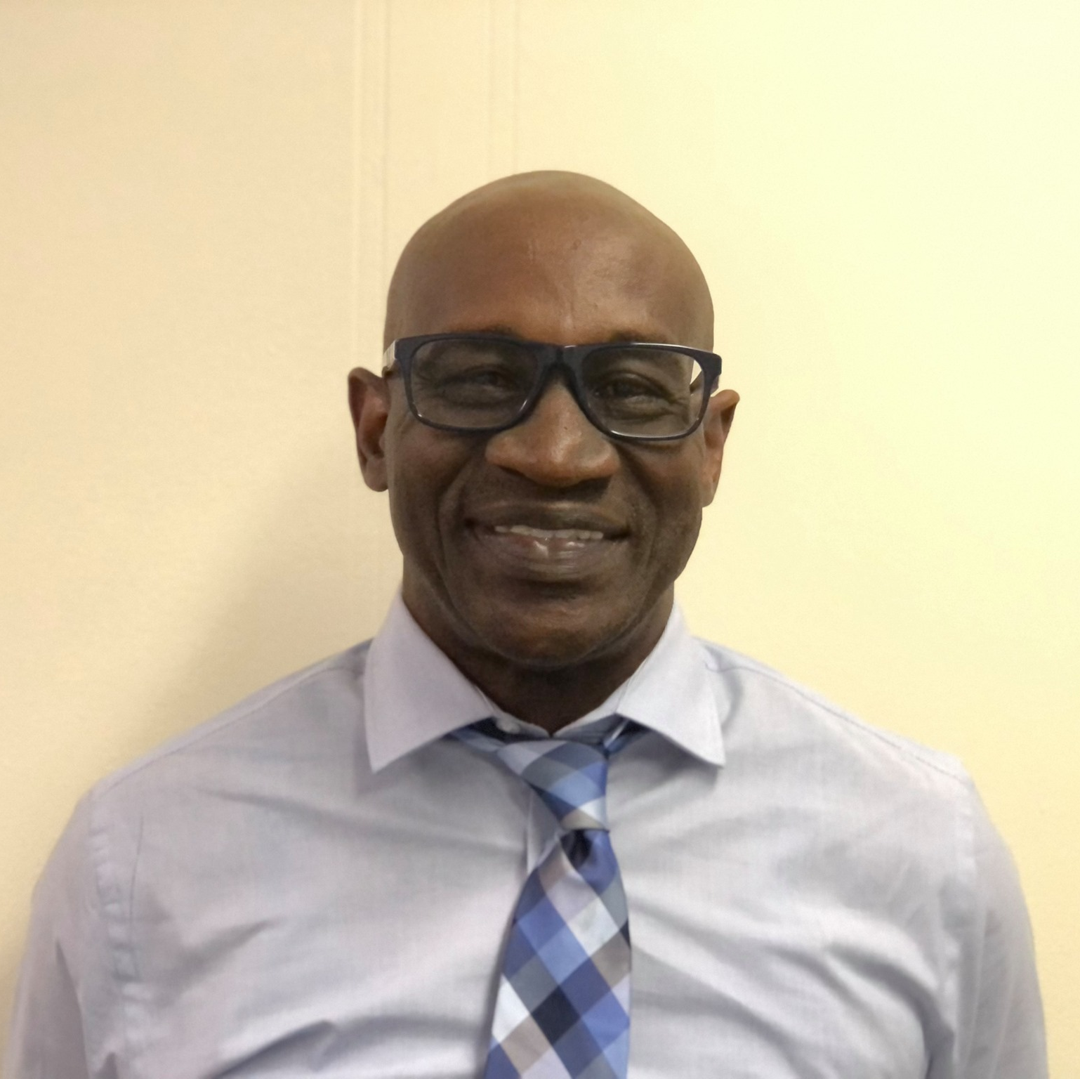
TAM Staffing
Please welcome Leslie Hannibal!
Director‘s Report
July 16, 2021

Slide 4
GABTR Update
GABTR Roster Updates:
Ben Jackson
Glenn Lockhart
Michelle Morales
Director‘s Report
July 16, 2021

Slide 5
Financial Update
 | FY17 Actuals | FY18 Actuals | FY19 Actuals | FY20 Actuals | FY21 Projections
Beginning Balance | $14,404,421 | $14,229,803 | $13,907,802 | $13,883,429 | -
Revenue (Interest) | $0 | $0 | $0 | $0 | -
Revenue | $2,961,097 (@ $0.5/acct) | $2,427,978 | $2,633,409 | $2,868,810 | $15,707,736
Expenditures | $3,135,715 | $2,749,979 | $2,347,288 | $2,550,021 | $2,835,146
Beginning BRFA Transfers | $0 | $0 | $0 | $0 | -
Ending Balance | $14,229,803 | $13,907,802 | $13,883,429 | $14,202,218 | $12,872,590
Director‘s Report
January 15, 2021

Slide 6
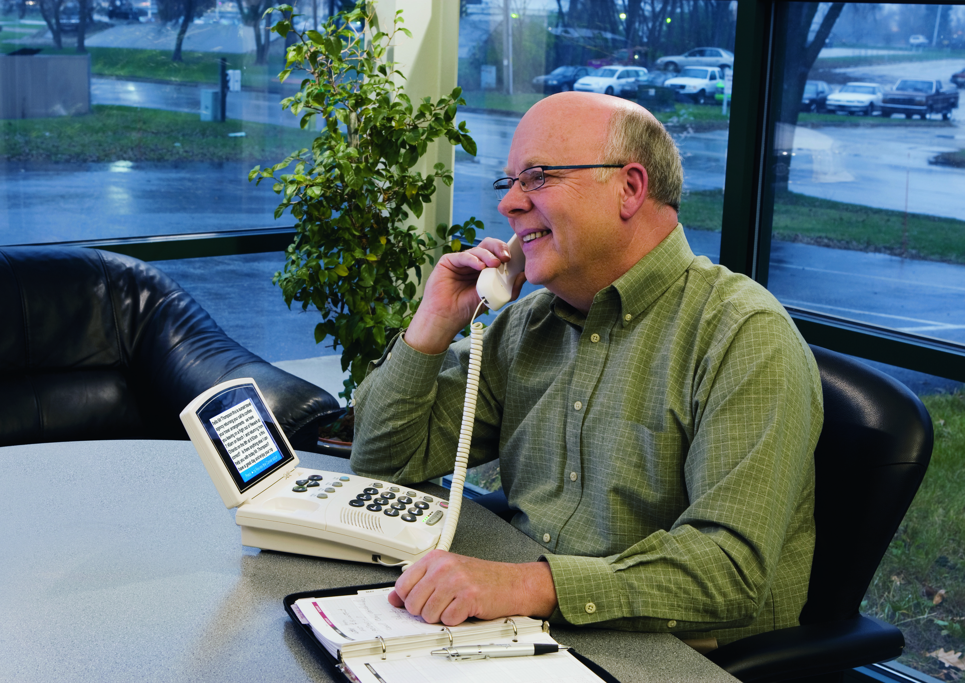
Topics
RTT and 9-1-1
The future of Relay Services
Director‘s Report
July 16, 2021

Slide 7

Questions?

Slide 8

Manager Report
Travis Dougherty
Maryland Relay Manager
travis.dougherty@maryland.gov | 202-753-9119 (VP)

Slide 9
RCC Service
Strong Growth with RCC Service
16,320
14,280
11,400
8,385
7,605
4,440
January 2021
February 2021
March 2021
April
2021
May
2021
June
2021
Maryland Relay Manager Report
July 16, 2021

Slide 10
RCC Updates
RCC Focus Group
RCC Approval Process
Maryland Relay Manager Report
July 16, 2021

Slide 11

FCC’s Disability Advisory Council
Emerging Technology Workgroup
Maryland Relay Manager Report
July 16, 2021

Slide 12
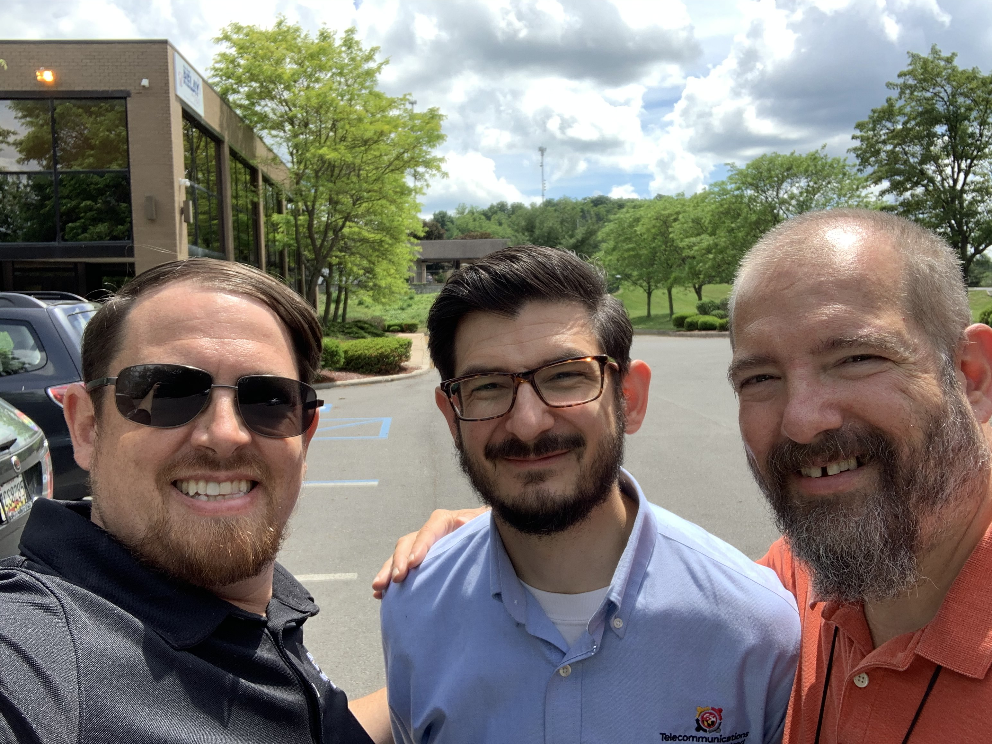
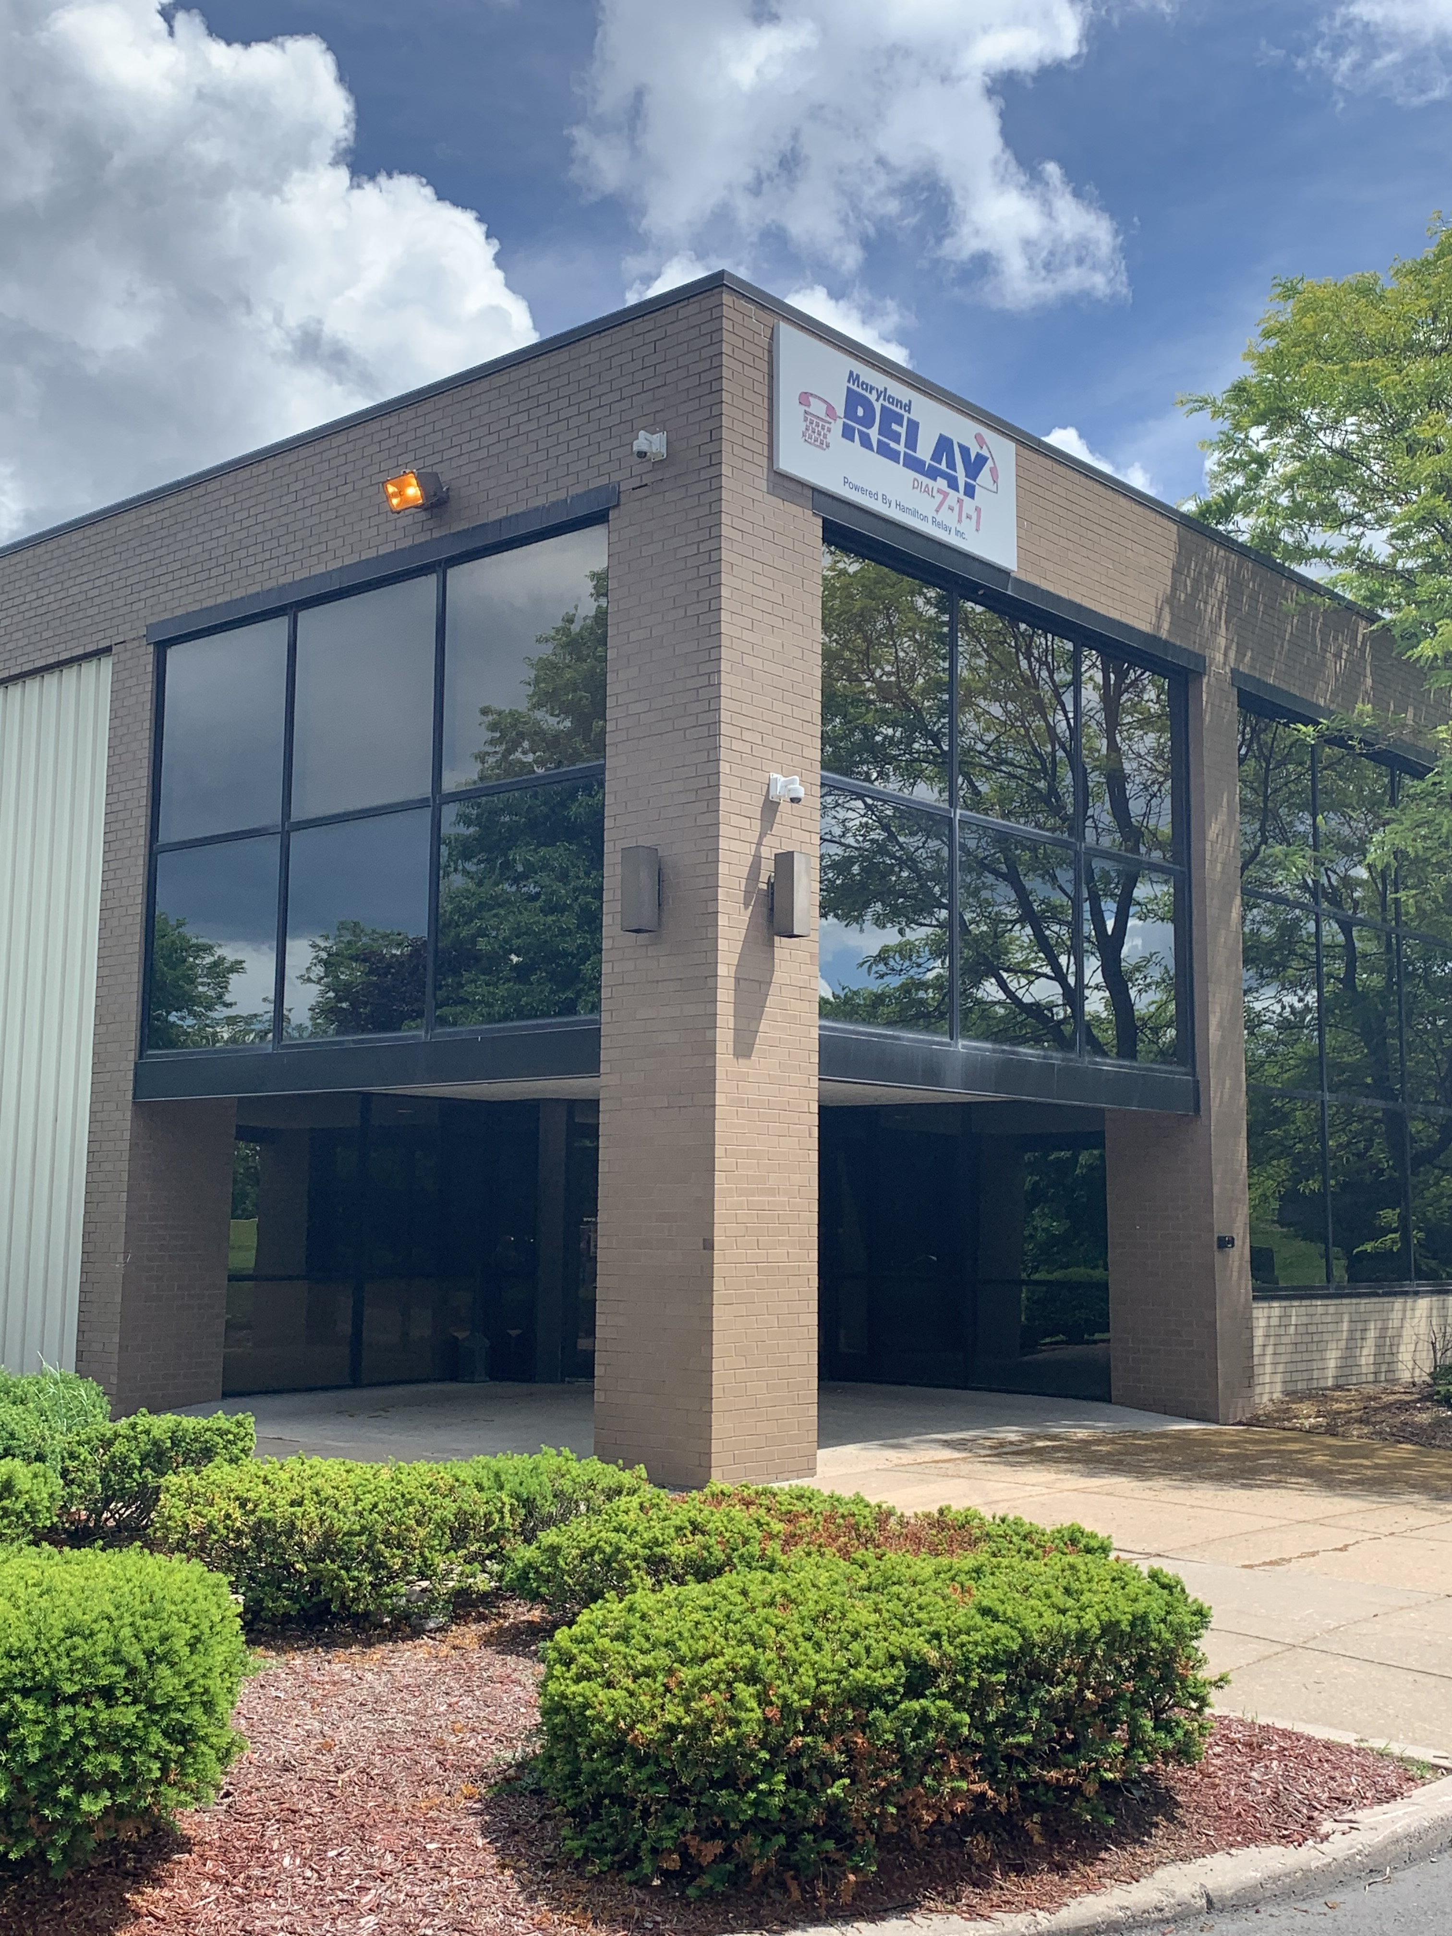
Visiting Hamilton Relay’s Frostburg Call Center
Maryland Relay Manager Report
July 16, 2021

Slide 13
Upcoming Plan
RTT Focus Group
RCC Guidelines Draft
NASRA’s webinar on new relay products for DeafBlind users – July 20
30th Anniversary of Maryland Relay/TAM
TAM Museum
Maryland Relay Manager Report
July 16, 2021

Slide 14
Questions?

Slide 15

MAT Manager Report
Kevin Steffy
MAT Manager
kevin.steffy@maryland.gov | 443-852-6717 (SMS)

Slide 16
General Updates
From January to March 2021, MAT has received 53 new applications and distributed a total of 50 pieces of telecommunications equipment.
In the previous quarterly report, we distributed a total of 59 pieces of telecommunications equipment.
There is a difference of 9 equipment pieces between the previous and current quarters.
Evaluators can do the evaluation/re-evaluation/troubleshooting in person with or without face masks if both client and evaluator feel comfortable meeting in person. Also, if evaluation centers allow, clients can come into the center.
We still are doing our service remotely to protect our clients’ health. If we must meet with clients in person, we use PPE and make sure that everything is properly sanitized.
MAT Manger Report
July 16, 2021

Slide 17
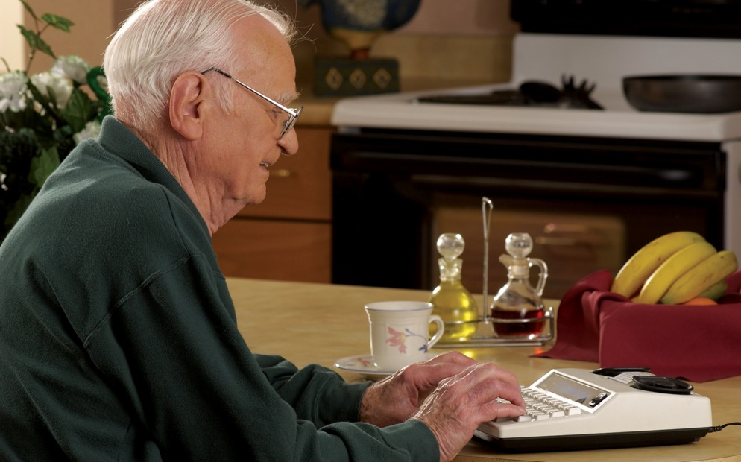
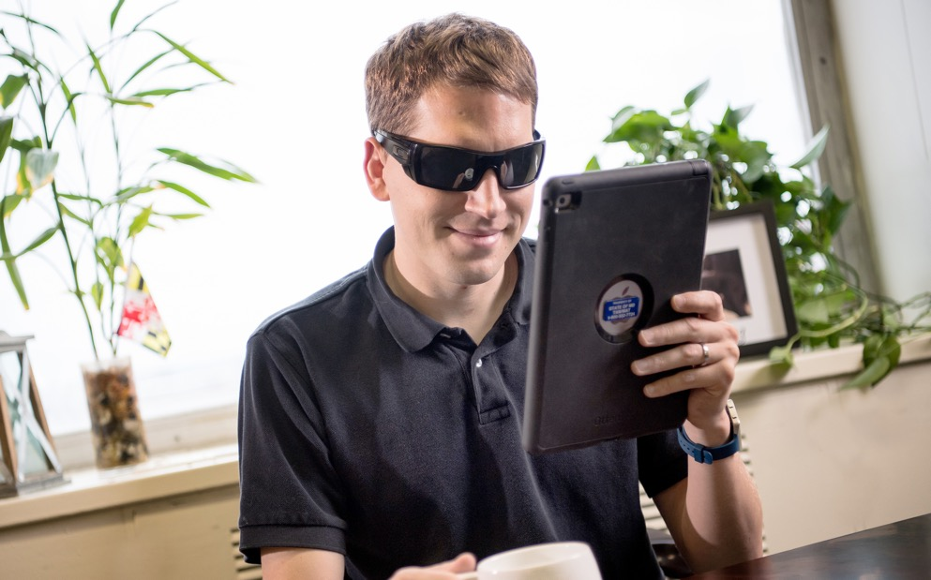
Equipment Update
Below are the numbers for distributed equipment from April to June 2021
Amplified Phone: 23
Braille Phone Device for the DeafBlind: 1
Captioned Telephone: 10
Cordless Phone: 1
Hands-Free Phone: 2
iPad: 6
Memory Dialing Aid: 3
Phone Ring Signaler: 3
Speakerphone: 2
MAT Manger Report
July 16, 2021

Slide 18
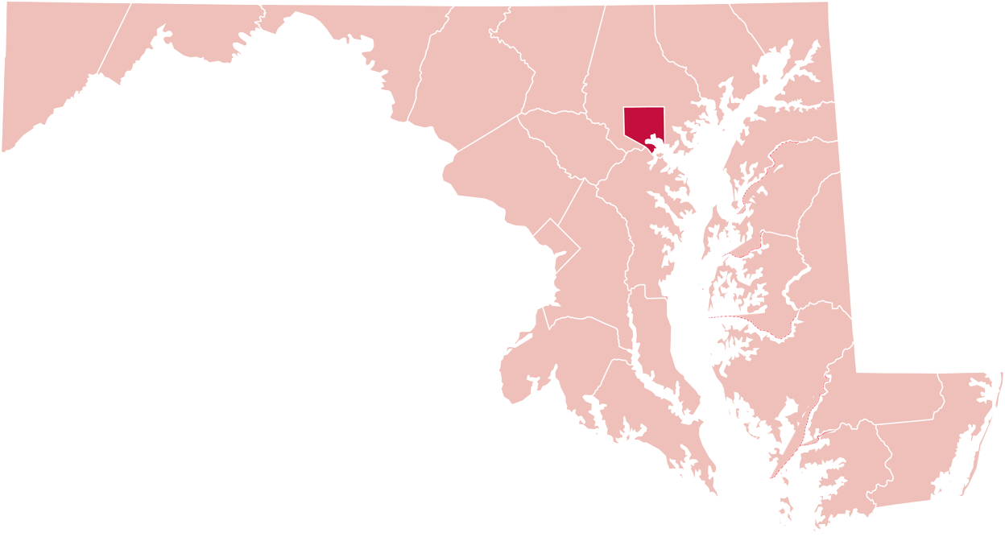
Equipment Update
Below are the numbers for distributed equipment by county from April to June 2021
12
Baltimore County
1
Baltimore City
Garrett County
6
1
Harford County
7
2
Anne Arundel County
Frederick County
3
Caroline County
Howard County
2
4
Wicomico County
Prince George’s County
1
MAT Manger Report
July 16, 2021

Slide 19
Equipment Update
Below are the numbers for distributed equipment from July 2020 to June 2021
Amplified Answering Machine: 1
Amplified Phone: 157
Amplified Phone with Amplified Voice Output: 7
Captioned Telephone: 36
Cordless Phone: 1
Hands-Free Phone: 4
iPad: 89
Memory Dialing Aid: 4
Miscellaneous: 1
Phone Ring Signaler: 4
Speakerphone: 2
Synthetic Speech System: 1
Wireless Device: 15
MAT Manger Report
July 16, 2021

Slide 20
Equipment Update
Below are the numbers for distributed equipment by county from July 2020 to June 2021
Allegany County
2
Carroll County
6
65
Baltimore County
1
Cecil County
2
Baltimore City
11
Harford County
Garrett County
43
Washington County
17
5
Queen Anne’s County
Frederick County
21
4
Talbot County
Montgomery County
11
1
Calvert County
Howard County
13
2
Dorchester County
Prince George’s County
13
8
Wicomico County
St Mary’s County
4
4
Worcester County
MAT Manger Report
Anne Arundel County
11
July 16, 2021

Slide 21

Focus Groups
We hosted our final 2 focus group virtual webinars for Deaf and DeafBlind on June 30th.
I hosted and ran the webinar with several pieces of equipment for each group.
Those webinars were successful.
DeafBlind
Deaf
iPhone, Pixel 4a, Mobile Sensor, Square Glow
1 participant showed up
iPad Pro, Pixel 4a, iPhone 11 Pro Max, Page Receiver
3 participant showed up
MAT Manger Report
July 16, 2021

Slide 22
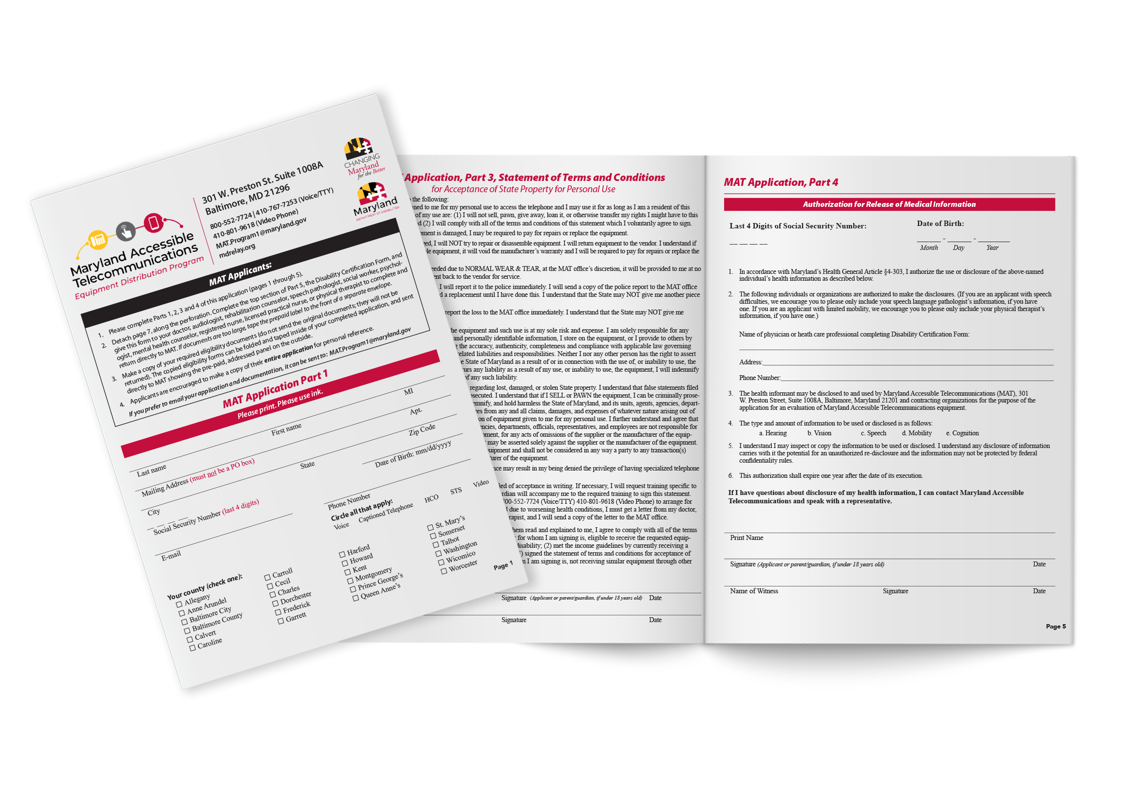
MAT Application Form
The Devaney team, Donna Broadway-Callaman, and I will meet to add E-Signature, Spanish, Large fonts, and braille to the MAT application form.
The issue with Requirement: Minority Business Enterprise (MBE), Veteran-Owned Small Business Enterprise (VSBE), and Mercury
MAT Manger Report
July 16, 2021

Slide 23
Assistance Telecommunications Equipment (ATE)
ATE Request for Approval (RFP)
The committee (Jane Hager, Rachel Horowitz (DORS), Steven Collins (Gallaudet), Nai Damato, Eddie Martinez (president of MWADB), and I), have been working on developing:
List of training for CF
List of qualifications from DeafBlind individuals to be qualified for the CF service
The rate for CF service
Contract for scheduler position
QR Code
Hopefully, we will start the CF program this Fall.
Director‘s Report
July 16, 2021

Slide 24
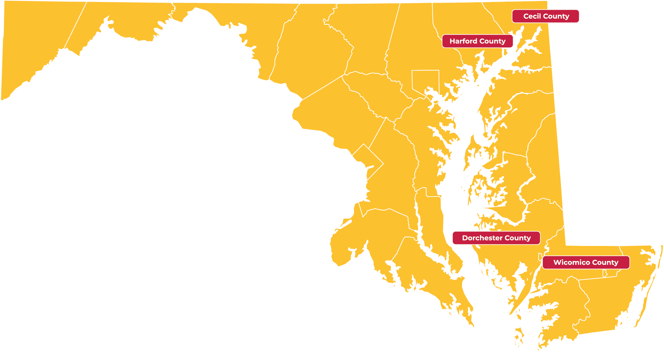
Evaluation Centers
Lori from MDTAP, Jane Hager, and I have been working to find spaces in some areas like the Northeastern area and Middle and Lower shores. We found some centers that we thought fit perfect for our programs in Harford, Cecil, Dorchester, and Wicomico Counties. However, we just found that we are supposed to go through the Department of General Service (DGS) Office of Real Estate, and they will take care of it for us.
Director‘s Report
July 16, 2021

Slide 25
Questions?

Slide 26
Public Relations & Outreach Report
Donna Broadway-Callaman
Community Outreach Manager
donnat.broadway-callaman@maryland.gov | 410-582-6158

Slide 27
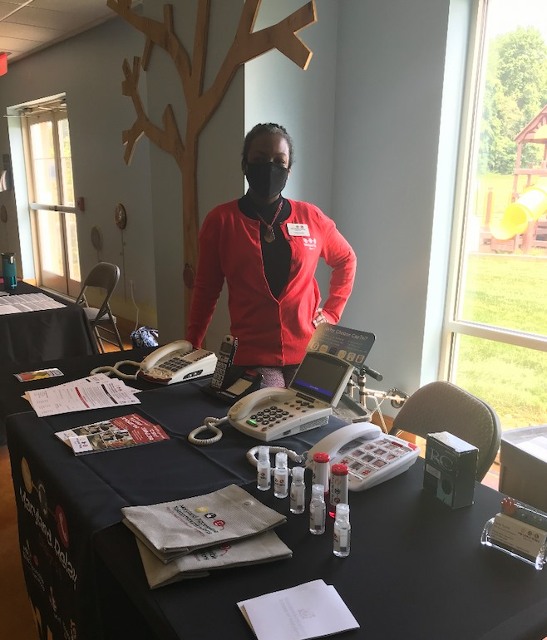
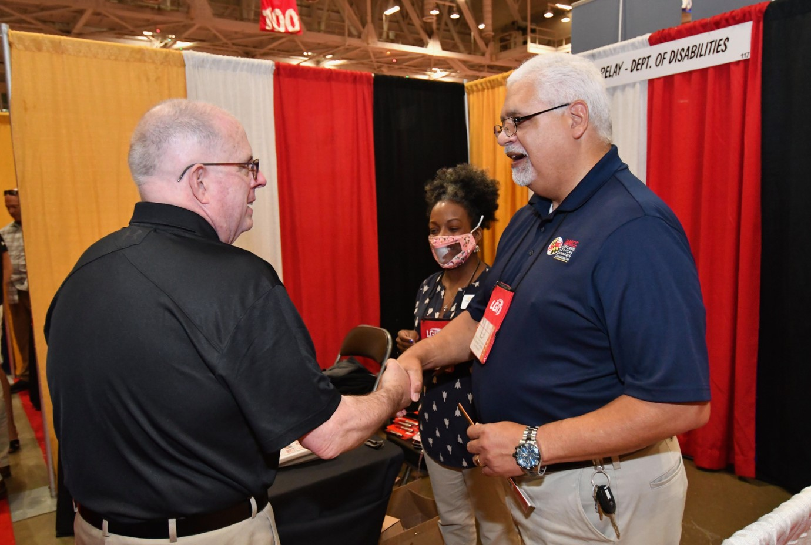
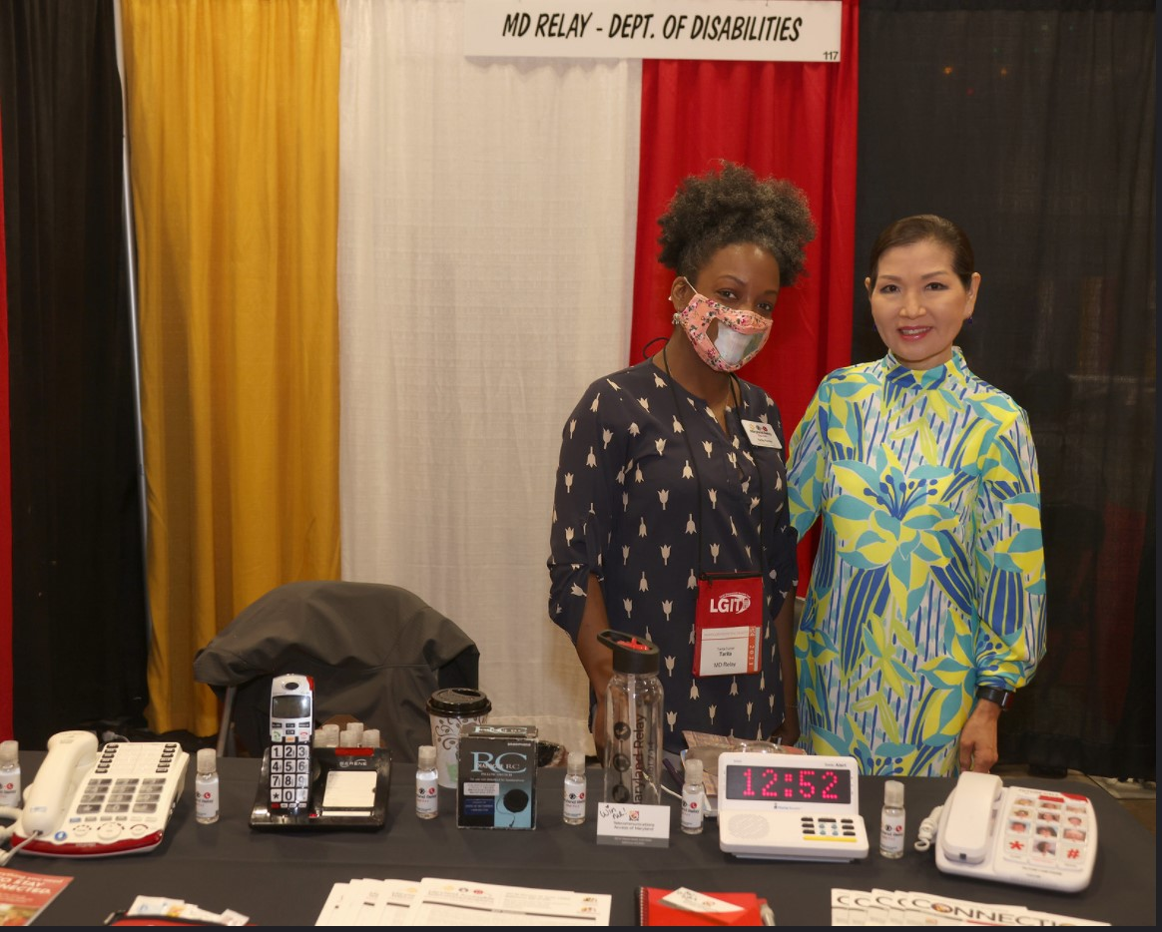
What’s New With Maryland Relay?
In person outreach has started again.
Tarita attended the Special Needs Conference on June 5 at The Church at Severn Run in Severn, Maryland.
We recently attended the Maryland Municipal League conference in Ocean City.
Special Needs Conference at The Church at Severn Run in Severn, MD
Tarita Turner attended the conference on June 5
Maryland Municipal League Conference in Ocean City, MD
Governor Larry Hogan and First Lady Yumi Hogan stopped to visit the exhibitor booths.
Public Relations & Outreach Report
July 16, 2021

Slide 28
What’s New With Maryland Relay?
Upcoming Outreach Events:
I will be attending the National Association of Counties (NACO) in National Harbor in July.
Several of us from TAM/Maryland Relay, and the Department of Disabilities including Kim McKay and Secretary Carol Beatty will be attending the Maryland Association of Counties conference (MACO) in Ocean City in August.
We will also be attending the MD ADA conference in September.
Jenny has been approved by TAM to attend the Seniors on the go Expo in Carroll County and the Harford Senior Expo conference in September.
Public Relations & Outreach Report
July 16, 2021

Slide 29
What’s New With Maryland Relay?
Governor Hogan is not requiring state employees to wear masks, but we strongly recommend PPE equipment.
Our OC’s are required by Hamilton to wear PPE while exhibiting and presenting.
Public Relations & Outreach Report
July 16, 2021

Slide 30
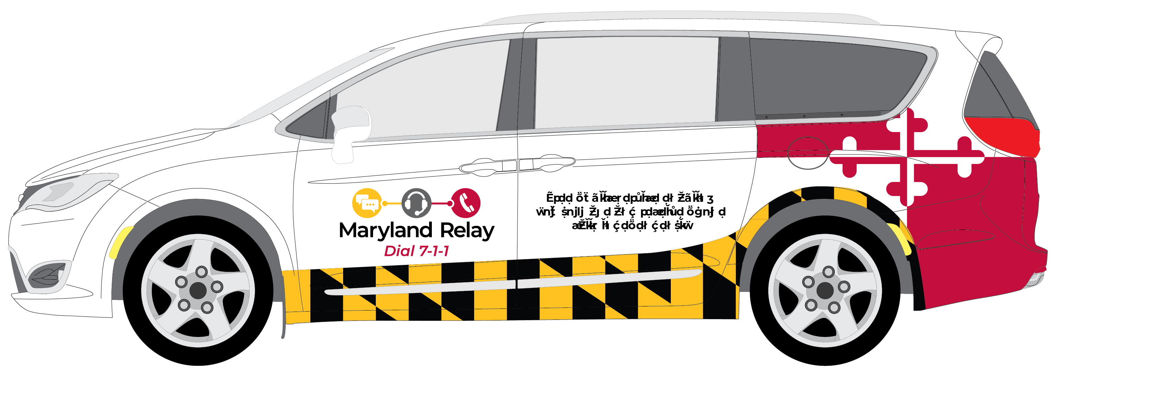
What’s New With Maryland Relay?
We are planning our 30th anniversary celebration which will be held later this year or early next year.
We are working with DoD on the 30th anniversary of the ADA in July.
We are still working with the MAT program to promote CapTel and other MAT services.
We have created new collateral and are working on Lunch & Learn programs that will be available in each county and Baltimore City.
We are also working on creating the wrap for the new van and updating our table-cloths, banner stands, and table runners for in person outreach.
Public Relations & Outreach Report
July 16, 2021

Slide 31
Post-Pandemic Outreach
Advertising
Webinars
Mailings
Virtual/hybrid events
Networking/making new contacts
Public Relations & Outreach Report
July 16, 2021

Slide 32
Questions?

Slide 33

Hamilton Relay
Updates

Slide 34
Maryland TRS
Percent Answered in 10 seconds
Hamilton Relay Report
July 16, 2021

Slide 35
Maryland Captioned Telephone
Percent Answered in 10 seconds
Hamilton Relay Report
July 16, 2021

Slide 36
Maryland TRS
Session & Conversation Minutes
Hamilton Relay Report
July 16, 2021

Slide 37
Maryland Captioned Telephone
Session & Conversation Minutes
Hamilton Relay Report
July 16, 2021

Slide 38
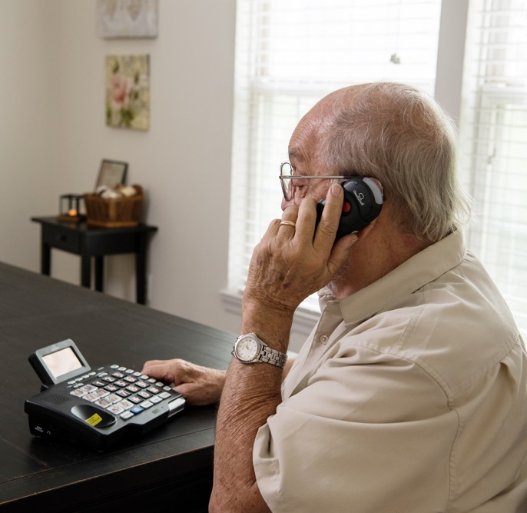
Maryland TRS
Customer Care Contacts
 | March | April | May
Technical | 0 | 0 | 0
General Information | 12 | 19 | 11
Equipment | 3 | 2 | 5
Customer Profile | 0 | 1 | 3
Outreach | 0 | 0 | 0
Operations Complaints | 0 | 0 | 0
External Complaints | 1 | 0 | 0
Wrong Number/Hang Up | 44 | 38 | 46
Compliments/Commendations | 0 | 0 | 0
Malicious Caller | 0 | 0 | 0
Hamilton Relay Report
July 16, 2021

Slide 39
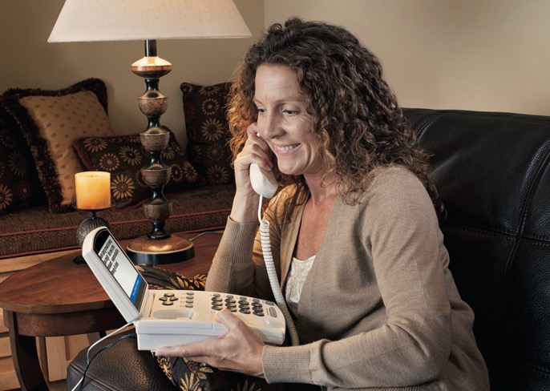
Maryland Captioned Telephone
Customer Care Contacts
 | March | April | May
Service | 0 | 0 | 0
Technical | 0 | 0 | 0
Product | 0 | 0 | 0
Billing | 0 | 0 | 0
Setup | 0 | 0 | 2
Info/Referral/Ed | 0 | 0 | 2
Other | 0 | 0 | 0
Hamilton Relay Report
July 16, 2021

Slide 40
Outreach Activity
2
Virtual Exhibits
24
Presentations
40
Networking
34
Meetings
4
Sponsorship
Organizations
(included webinars, virtual presentations, and a new Relay Partner training)
Hamilton Relay Report
July 16, 2021

Slide 41
Outreach Highlights
Award Programs
  Scholarship Award Winner
  Better Hearing & Speech Month
  Deaf Community Leader Award (DAW)
Pro Aging Sponsorship
RTT Presentations
Collaboration for presentation(s) with GABTR board members
Hamilton Relay Report
July 16, 2021

Slide 42
Questions?

Slide 43
Thank you!
July 16, 2021

