Slide 1

Governor’s Advisory Board for Telecommunications Relay
October 15, 2021

Slide 2

Director’s Report
David Bahar
Director
david.bahar@maryland.gov | 240-319-9199 (SMS)

Slide 3

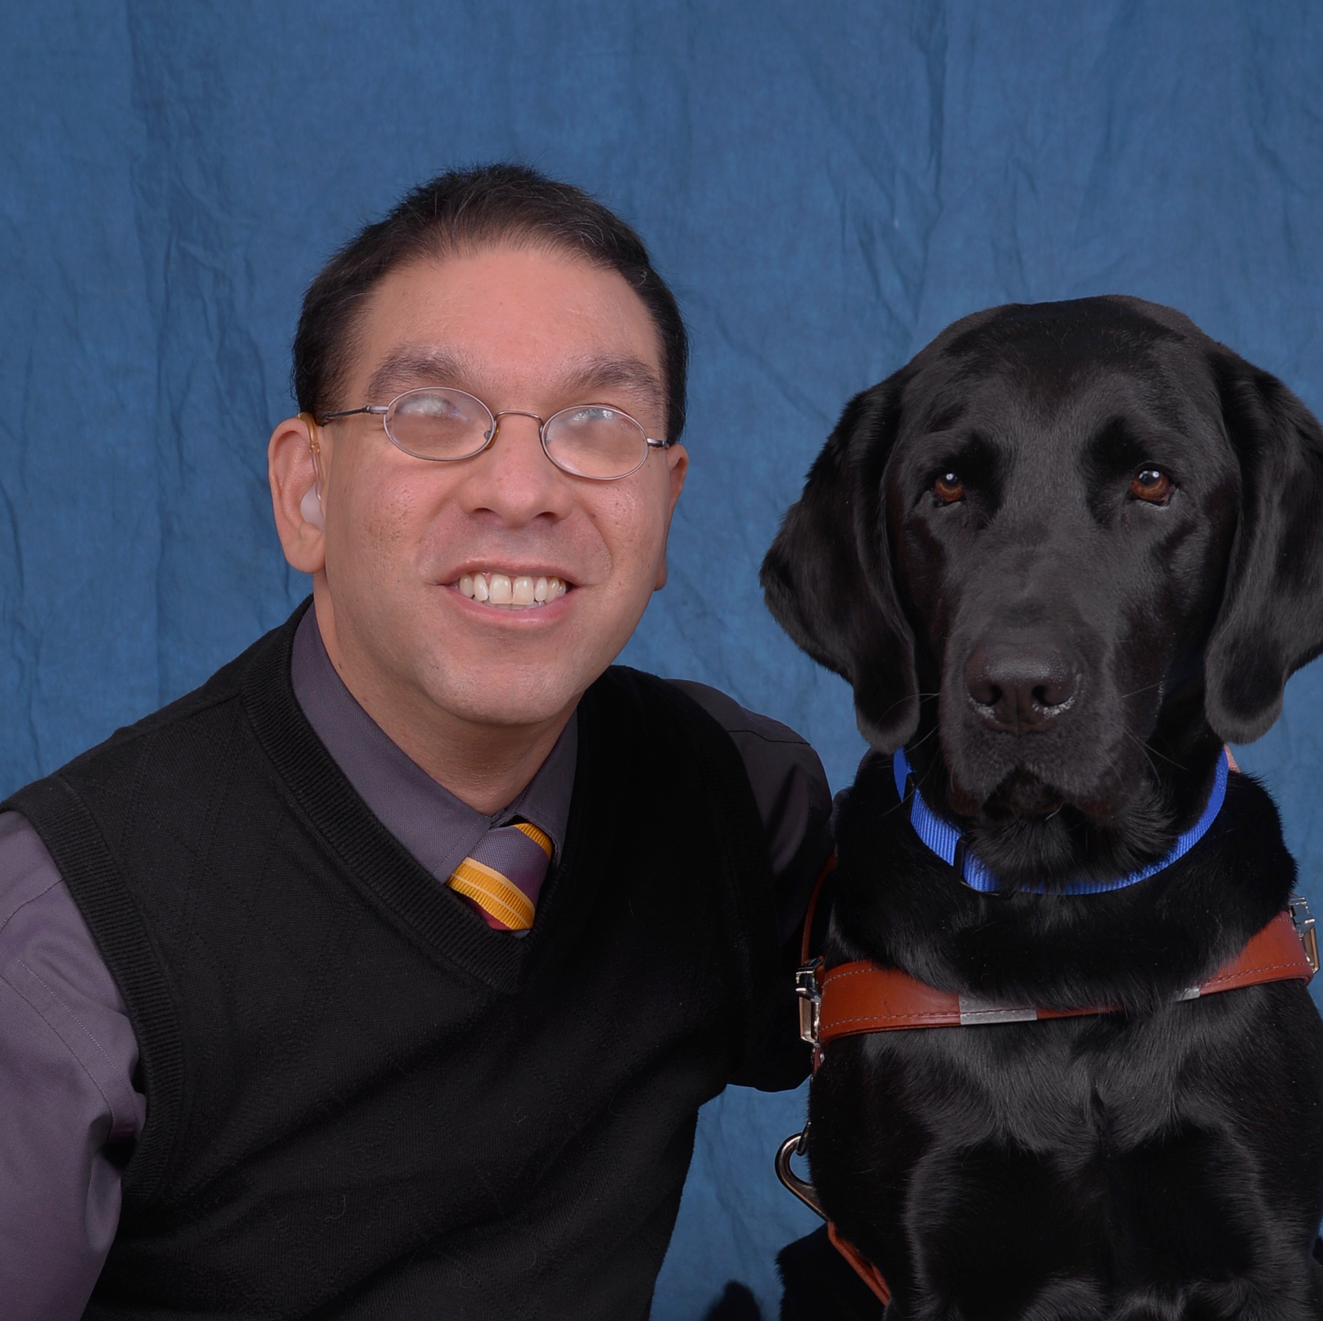
TAM Staffing
Please welcome
Eddie Martinez, Jr.,
MAT Program Deafblind Specialist
Director‘s Report
October 15, 2021

Slide 4
Financial Update
 | FY17 Actuals | FY18 Actuals | FY19 Actuals | FY20 Actuals | FY21 Projections
Beginning Balance | $14,404,421 | $14,229,803 | $13,907,802 | $13,883,429 | -
Revenue (Interest) | $0 | $0 | $0 | $0 | -
Revenue | $2,961,097 (@ $0.5/acct) | $2,427,978 | $2,633,409 | $2,868,810 | $15,707,736
Expenditures | $3,135,715 | $2,749,979 | $2,347,288 | $2,550,021 | $2,835,146
Beginning BRFA Transfers | $0 | $0 | $0 | $0 | -
Ending Balance | $14,229,803 | $13,907,802 | $13,883,429 | $14,202,218 | $12,872,590
FY2023 budget request submitted and we are asking for approximately the same budget as FY2022. Leslie will provide further details in his report. We have requested funds for two additional specialists for the MAT program in the FY23 budget.
Director‘s Report
October 15, 2021

Slide 5
Senior Call Check (SCC) program
The Senior Call Check (SCC) program will request approximately $375,000 for their FY23 budget, a significant reduction from the $627,939 that was requested for FY2022.
As a result, the SCC impact on the USTF will be less severe, and the USTF is projected to carry a positive balance through at least FY2027 without an adjustment to the per-account rate currently set at 0.05.
Director‘s Report
October 15, 2021

Slide 6
TAM Real Estate Updates
Preliminary discussions were held with the DGS Office of Real Estate regarding future relocation from State Center in Baltimore.
The State Center complex is scheduled to be demolished in the near future to make way for new real estate development.
DGS is working with all State Center agencies to identify suitable locations for relocation in the city of Baltimore, between 40th street to the north and Pratt Street to the south.
Director‘s Report
October 15, 2021

Slide 7
TAM Regulatory Updates
Travis Dougherty continues to serve DAC as a representative of the National Association of State Relay Administration (NASRA).
TAM continues to work on issues relating to Real-time Text (RTT). Conversations are ongoing between TAM, TDI, NAD and NASRA about the next steps in our effort to launch RTT relay services. TAM requested and NASRA agreed to draft a letter to the FCC asking for them to move on to the second phase of their RTT rulemaking.
Director‘s Report
October 15, 2021

Slide 8

Questions?

Slide 9
Finance Manager Report
Leslie Hannibal
TAM Finance Manager
Leslie.hannibal2@maryland.gov | 443-767-6971 (office)

Slide 10
USTF Financial Statement
Universal Service Trust Fund
Fiscal Year Actuals & Projections
Description | Fiscal Year-End | Jul | Aug | Sep | Oct | Nov | Dec | Jan | Feb | Mar | Apr | May | Jun
Beginning Balance FY2016 | $12,613,123
Revenue (USTF Revenue Transfers) | $5,349,363 | 452,160 | 519,521 | 456,997 | 448,579 | 452,681 | 450,586 | 448,676 | 464,488 | 466,873 | 455,704 | 460,537 | 272,560
Actual Expenditures | $3,558,065 | 152,177 | 3,143,804 | 66,966 | 48,984 | 85,735 | 86,758 | 119,560 | 78,975 | 72,810 | 64,439 | 137,313 | (499,456)
Transfers per the BRFA
Ending Balance FY2016 | $14,404,421
Beginning Balance FY2017 | $14,404,421
Revenue (USTF RevenueTransfers) | $2,961,097 | 299,740 | 282,669 | 265,244 | 286,423 | 274,950 | 267,961 | 269,406 | 218,924 | 196,626 | 203,103 | 192,281 | 203,770
Actual Expenditures | $3,135,715 | 175,142 | 1,383,035 | 104,084 | 1,152,858 | (909,848) | 59,473 | 58,240 | 73,093 | 89,074 | 219,427 | 64,126 | 667,011
Transfers per the BRFA | $-
Ending Balance FY2017 | $14,229,803
Beginning Balance FY2018 | $14,229,803
Revenue (USTF RevenueTransfers) | $2,427,978 | 179,164 | 178,257 | 190,818 | 180,933 | 187,305 | 182,662 | 190,195 | 204,247 | 265,841 | 221,628 | 221,912 | 225,016
Actual Expenditures | $2,749,979 | 37,064 | 65,596 | 467,482 | 181,772 | 193,911 | 222,948 | 307,795 | 113,112 | 191,323 | 350,316 | 230,162 | 388,497
Transfers per the BRFA | $-
Ending Balance FY2018 | $13,907,802
TAM Finance Manager Report
October 15, 2021

Slide 11
USTF Financial Statement
Beginning Balance FY2020 | $13,883,429
Revenue (Interest) | $-
Revenue (USTF RevenueTransfers) | $2,718,880 | 200,911 | 215,690 | 213,942 | 218,100 | 227,513 | 204,294 | 223,335 | 271,588 | 230,367 | 251,724 | 233,959 | 227,458
Actual / Projected Expenditures | $3,340,493 | 51,231 | 42,977 | 213,831 | 208,592 | 533,572 | 179,554 | 187,838 | 98,618 | 70,285 | 169,513 | 416,623 | 1,167,859
Transfers per the BRFA | $-
Projected Ending Balance FY2020 | $13,261,817
Beginning Balance FY2021 | $-
Revenue (Interest)
Revenue (USTF RevenueTransfers) | $16,044,194.18 | - | - | - | - | 231,082.16 | 251,494.63 | 228,320.58 | 14,078,454.70 | 230,661.08 | 243,988.52 | 221,771.42 | 558,421.09
Actual / Projected Expenditures | $3,633,265.12 | - | - | 15,547.12 | 43,251.72 | 182,628.51 | 21,953.49 | 970,239.85 | 48,503.66 | 107,579.11 | 709,939.20 | 191,940.63 | 1,341,681.83
Transfers per the BRFA
Projected Ending Balance FY2021 | $12,410,929.06
Beginning Balance FY2022 | $12,410,929.06
Revenue (Interest)
Revenue (USTF RevenueTransfers) | $- | - | - | - | - | - | - | - | - | - | - | - | -
Actual / Projected Expenditures | $664,701.57 | 26,868.59 | 179,409.79 | 458,423.19 | - | - | - | - | - | - | - | - | -
Transfers per the BRFA
Projected Ending Balance FY2021 | $11,746,227.49
TAM Finance Manager Report
October 15, 2021

Slide 12
USTF Financial Statement
Verification
Beginning Balance FY2019 | $ 13,907,802.26
Revenue (USTF RevenueTransfers) | $ 2,632,610.37
Actual Expenditures | $ 2,656,983.16
Ending Balance FY2019 | $ 13,883,429.47
Revenue (USTF RevenueTransfers) | $ 2,257,463.38
Actual Expenditures | $ 2,204,106.98
Ending Balance FY2020 | $ 13,936,785.87
Beginning Balance FY2021 | $ -
Revenue (USTF RevenueTransfers) | $ 16,044,194.18
Actual Expenditures | $ 3,633,265.12
Ending Balance FY2021 | $ 12,410,929.06
Beginning Balance FY2021 | $ 12,410,929.06
Revenue (USTF RevenueTransfers) | -
Actual Expenditures | 664,701.57
Ending Balance FY2021 | $ 11,746,227.49
TAM Finance Manager Report
October 15, 2021

Slide 13
Revenue
 | FY2016 | FY2017 | FY2018 | FY2019 | FY2020 | FY2021 | FY2022 | FY2023
Month | USTF Actual Revenue (Transfers) | USTF Actual Revenue (Transfers) | USTF Actual Revenue (Transfers) | USTF Actual Revenue (Transfers) | USTF Actual Revenue (Transfers) | USTF Actual / Projected Revenue (Transfers) | USTF Allowance Revenue (Transfers) | USTF Allowance Revenue (Transfers)
July | $452,160 | $299,740 | $179,164 | $218,731 | $200,911 | $0 | $0 | $226,573
August | 519,521 | 282,669 | 178,257 | 222,491 | $215,690 | $0 | $0 | $226,573
September | 456,997 | 265,244 | 190,818 | 217,874 | $213,942 | $0 | $0 | $226,573
October | 448,579 | 286,423 | 180,933 | 221,353 | $218,100 | $0 | $0 | $226,573
November | 452,681 | 274,950 | 187,305 | 218,500 | $227,513 | $231,082 | $0 | $226,573
December | 450,586 | 267,961 | 182,662 | 216,985 | $204,294 | $251,495 | $0 | $226,573
January | 448,676 | 269,406 | 190,195 | 218,074 | $223,335 | $228,321 | $0 | $226,573
February | 464,488 | 218,924 | 204,247 | 212,065 | $271,588 | $14,078,455 | $0 | $226,573
March | 466,873 | 196,626 | 265,841 | 227,968 | $230,367 | $230,661 | $0 | $226,573
April | 455,704 | 203,103 | 221,628 | 221,763 | $251,724 | $243,989 | $0 | $226,573
May | 460,537 | 192,281 | 221,912 | 222,241 | $233,959 | $221,771 | $0 | $226,573
June | 272,560 | 203,770 | 225,016 | 214,566 | $227,458 | $558,421 | $0 | $226,573
TOTAL | $5,349,363 | $2,961,097 | $2,427,978 | $2,632,610 | $2,718,880 | $16,044,194 | $0 | $2,718,880
 |  |  |  | Prior FY Actual | Prior FY Actual | Prior FY Actual | Current FY Actual | Budget Request
Rate: | $0.10 | $0.05 | $0.05 | $0.05 | $0.05 | $0.05 | $0.05
TAM Finance Manager Report
October 15, 2021

Slide 14
Exp. & Enc.
 | FY2017 | FY2018 | FY2019 | FY2020 | FY2021 | FY2022 | FY2023
Month | USTF Actual Expenditures | USTF Actual Expenditures | USTF Actual Expenditures | USTF Actual Expenditures | USTF Actual Expenditures | USTF Budget Allowance Expenditures | USTF Budget Allowance Expenditures
July | $175,142 | $37,064 | $207,740 | $51,231 | $0 | $26,869 | $432,644
August | $1,383,035 | $65,596 | $53,169 | $42,977 | $0 | $179,410 | $432,644
September | $104,084 | $467,482 | $132,657 | $213,831 | $15,547 | $458,423 | $432,644
October | $1,152,858 | $181,772 | $274,520 | $208,592 | $43,252 | $0 | $432,644
November | $(909,848) | $193,911 | $233,750 | $533,572 | $182,629 | $0 | $432,644
December | $59,473 | $222,948 | $44,980 | $179,554 | $21,953 | $0 | $432,644
January | $58,240 | $307,795 | $142,836 | $187,838 | $970,240 | $0 | $432,644
February | $73,093 | $113,112 | $264,761 | $98,618 | $48,504 | $0 | $432,644
March | $89,074 | $191,323 | $59,502 | $70,285 | $107,579 | $0 | $432,644
April | $219,427 | $350,316 | $310,909 | $169,513 | $709,939 | $0 | $432,644
May | $64,126 | $230,162 | $228,406 | $416,623 | $191,941 | $0 | $432,644
June | $667,011 | $388,497 | $703,753 | $1,167,859 | $1,341,682 | $0 | $432,644
TOTAL | $3,135,715 | $2,749,979 | $2,656,983 | $3,340,493 | $3,633,265 | $664,702 | $5,191,732
 |  |  | Prior FY Actual | Prior FY Actual | Prior FY Actual | Budget Request
Encumbrances: | $ - | $ - | $ - | $304,938 | $ - | $ -
TAM Finance Manager Report
October 15, 2021

Slide 15
Fund Balance
End Fund Balance (FY19 DAFR9090 / GAD G-8 Form) |  | $ 13,883,429.24 | June 30, 2019 | FY19 / 13
Plus (Minus): | Actuals / Projections - Fiscal Year 2020
 | AY 2020 (Revenue - Expense) Projection | (621,612.79)
Adjusted Fund Balance after Actuals / Projections |  | $ 13,261,816.45 | June 30, 2020 | IY 20 IM 13 | Fund Transfer occoured in FY21
Plus (Minus): | Actuals / Projections - Fiscal Year 2021 | $ -
 | AY 2021 (Revenue - Expense) Projection | $ 12,410,929.06
End Fund Balance (FY21 DAFR9090) |  | $ 12,410,929.06 | June 30, 2021
Fund Balance on USTF Summary |  | $ 12,410,929.06
Variance |  | $ -
TAM Finance Manager Report
October 15, 2021

Slide 16
FY20 Monthly Exp-Enc Changes
 | Prior AYs Expenditures (Increments)
 | FY19 / 13 | IY 20 IM 13 | Prior AY FY20 Increment
AY 2019 | $ 2,489,527 | $ 2,521,000 | $ 31,473
Subtotal |  |  | $ 31,473
 | Incremental - FY20 Monthly Expenditures
 | Inquiry Month | FYTD | Monthly Change | Encumbered
 | 1 | $ 19,759 | $ 19,759 | $ -
 | 2 | $ 62,735 | $ 42,977 | $ 1,544,375
 | 3 | $ 276,566 | $ 213,831 | $ 1,379,474
 | 4 | $ 485,159 | $ 208,592 | $ 1,339,368
 | 5 | $ 1,018,730 | $ 533,572 | $ 856,762
 | 6 | $ 1,198,285 | $ 179,554 | $ 707,728
 | 7 | $ 1,386,123 | $ 187,838 | $ 637,055
 | 8 | $ 1,484,741 | $ 98,618 | $ 671,929
 | 9 | $ 1,555,026 | $ 70,285 | $ 629,353
 | 10 | $ 1,724,539 | $ 169,513 | $ 1,096,348
 | 11 | $ 2,141,161 | $ 416,623 | $ 723,791
 | 12 & 13 | $ 3,309,020 | $ 1,167,859 | $ 304,938
Subtotal |  |  | $ 3,309,020 | 7/14/20
 |  | check total | $ 3,340,493 | IY 20 IM 13
TAM Finance Manager Report
October 15, 2021

Slide 17
FY20 Monthly Exp-Enc Changes
Incremental - FY21 Monthly Expenditures
Inquiry Month | FYTD | Monthly Change | Encumbered
1 | $ - | $ - | $ -
2 | $ - | $ - | $ -
3 | $ 15,547 | $ 15,547 | $ -
4 | $ 58,799 | $ 43,252 | $ 229,500
5 | $ 241,427 | $ 182,629 | $ 237,349
6 | $ 263,381 | $ 21,953 | $ 2,208,866
7 | $ 1,233,621 | $ 970,240 | $ 1,362,539
8 | $ 1,282,124 | $ 48,504 | $ 1,369,799
9 | $ 1,389,703 | $ 107,579 | $ 1,362,501
10 | $ 2,099,643 | $ 709,939 | $ 822,364
11 | $ 2,291,583 | $ 191,941 | $ 803,072
12 & 13 | $ 3,633,265 | $ 1,341,682 | $ 440,996
 |  | $ 3,633,265 | $ 8,836,985
Incremental - FY22 Monthly Expenditures
Inquiry Month | FYTD | Monthly Change | Encumbered
1 | $ 26,869 | $ 26,869 | $ -
2 | $ 206,278 | $ 179,410 | $ 2,574,698
3 | $ 664,702 | $ 458,423 | $ 2,270,564
4 | $ - | $ - | $ -
5 | $ - | $ - | $ -
6 | $ - | $ - | $ -
7 | $ - | $ - | $ -
8 | $ - | $ - | $ -
9 | $ - | $ - | $ -
10 | $ - | $ - | $ -
11 | $ - | $ - | $ -
12 & 13 | $ - | $ - | $ -
 |  | $ 664,702 | $ 4,845,262
 |  | $ 664,702
 |  | $ -
TAM Finance Manager Report
October 15, 2021

Slide 18

Manager Report
Travis Dougherty
Maryland Relay Manager
travis.dougherty@maryland.gov | 202-753-9119 (VP)

Slide 19
FCC DAC
New Work Groups
RTT on Wireline
TRS on Video Conference Platforms
Maryland Relay Manager Report
October 15, 2021

Slide 20

NASRA
NASRA elected as Member-at-Large
CTS CHAT webinar with NASRA and TEDPA
Maryland Relay Manager Report
October 15, 2021

Slide 21
RTT Developments
NASRA members voted to send a letter to FCC to request RTT to pass through N-1-1 and toll-free numbers
E911 Commission sent a letter to FCC and Carriers to request RTT to pass through their wireless network
Interoperable Accessibility Coalition
Maryland Relay Manager Report
October 15, 2021

Slide 22
RCC Developments
RCC Approval Process
RCC Regulation Updates
Federal Relay and GSA
Maryland Relay Manager Report
October 15, 2021

Slide 23
Questions?

Slide 24

MAT Manager Report
Kevin Steffy
MAT Manager
kevin.steffy@maryland.gov | 443-852-6717 (SMS)

Slide 25
General Updates
From July to September 2021, MAT has received 69 new applications and distributed a total of 69 pieces of telecommunications equipment.
In the previous quarterly report, we distributed a total of 50 pieces of telecommunications equipment.
There is a difference of 19 equipment pieces between the previous and current quarters.
MAT Manger Report
October 15, 2021

Slide 26


Equipment Update
Below are the numbers for distributed equipment from July to September 2021
Amplified Phone: 31
Amplified Phone with amplified voice output: 1
Captioned Telephone: 6
Cordless Phone: 10
Hands-Free Phone: 1
iPad: 18
Memory Dialing Aid: 1
Speakerphone: 1
MAT Manger Report
October 15, 2021

Slide 27
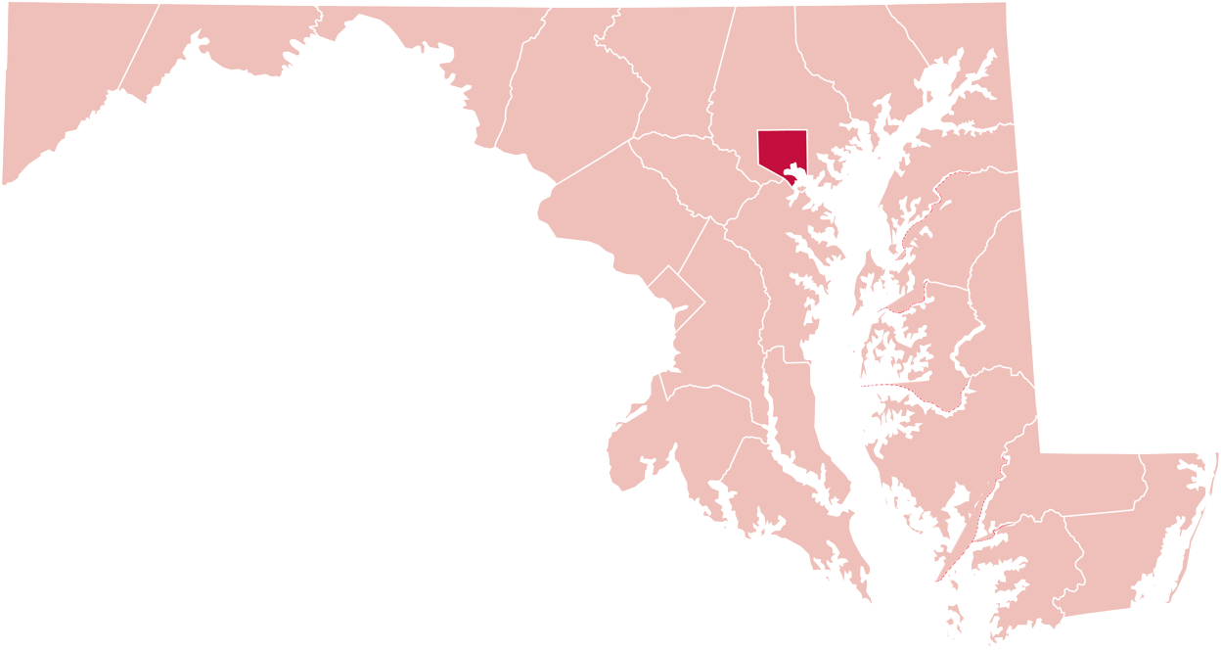
Equipment Update
Below are the numbers for distributed equipment by county from July to September 2021
Carroll County
1
118
Baltimore County
2
Baltimore City
Garrett County
16
8
Harford County
Washington County
2
2
Somerset
Queen Anne’s County
1
1
Frederick County
3
Anne Arundel County
Montgomery County
1
Howard County
8
2
Dorchester County
Prince George’s County
1
2
Wicomico County
St Mary’s County
1
MAT Manger Report
October 15, 2021

Slide 28
Equipment Update
Below are the numbers for distributed equipment from July 2020 to June 2021
Amplified Answering Machine: 1
Amplified Phone: 157
Amplified Phone with Amplified Voice Output: 7
Braille Phone Device for DeafBlind: 1
Captioned Telephone: 36
Cordless Phone: 1
Hands-Free Phone: 4
iPad: 89
Memory Dialing Aid: 4
Miscellaneous: 1
Phone Ring Signaler: 4
Speakerphone: 2
Synthetic Speech System: 1
Wireless Device: 15
MAT Manger Report
October 15, 2021

Slide 29
Equipment Update
Below are the numbers for distributed equipment by county from July 2020 to June 2021
Allegany County
2
Carroll County
6
65
Baltimore County
1
Cecil County
2
Baltimore City
11
Harford County
Garrett County
43
Washington County
17
5
Queen Anne’s County
Frederick County
21
4
Talbot County
Montgomery County
11
1
Calvert County
Howard County
13
2
Dorchester County
Prince George’s County
13
8
Wicomico County
St Mary’s County
4
4
Worcester County
MAT Manger Report
Anne Arundel County
11
October 15, 2021

Slide 30
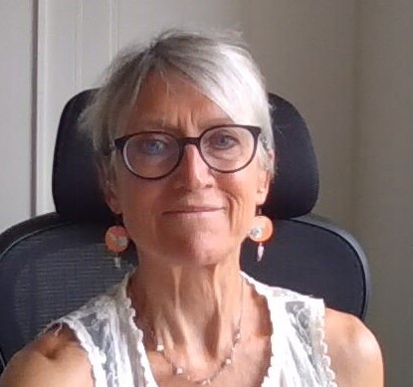
New Positions
Jane Hager
MAT Specialist
Eddie Martinez Jr.
MAT DeafBlind Specialist
MAT Manger Report
October 15, 2021

Slide 31
Lunch & Learn
We will host a Lunch & Learn for those professionals (physician, audiologist, rehabilitation counselor, speech language pathologist, social worker, psychologist, mental health counselor, nurse, and more health professionals).
Donna will share more information on the Lunch & Learn during her report.
MAT Manger Report
October 15, 2021

Slide 32
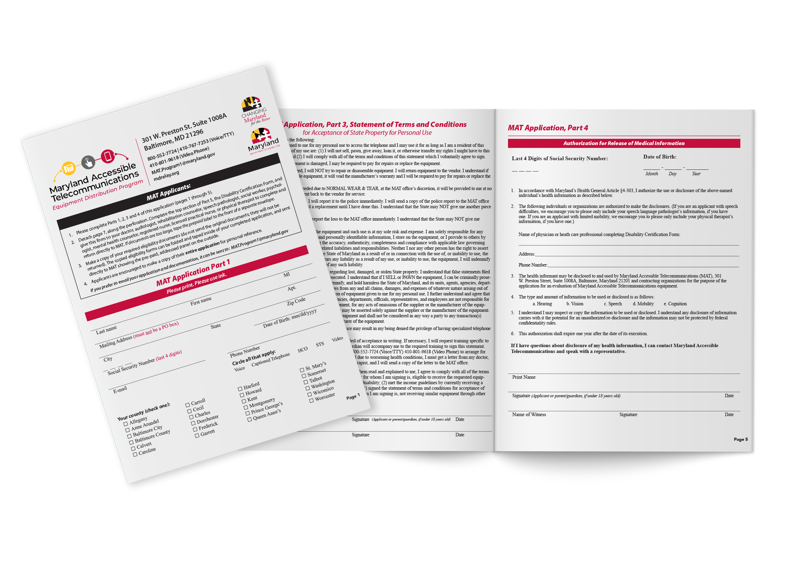
MAT Application Form
The issue with the BRM (Business Reply Mail) was solved.
Devaney created the MAT Application form with large fonts for low vision people and a Spanish version.
We will work on the application form with braille and add e-signature capability to our online application form.
MAT Manger Report
October 15, 2021

Slide 33
Assistance Telecommunications Equipment (ATE)
We will use Information for Bid (IFB) instead of Requestion for Proposal (RFP).
Director‘s Report
October 15, 2021

Slide 34
Communication Facilitator (CF):
The Communication Facilitator (CF) program enables DeafBlind (DB) individuals with sign language (American Sign Language) to access any kind of video platforms (for example videophone (VP), video relay services (VRS), Facetime (FT), Zoom, Skype, Google Hangout Meet, and more).
CF program is run and monitored by Maryland Accessible Telecommunications (MAT) program to provide CF services and video communication awareness for DB community members in Maryland.
A facilitator is a skilled signer who copies sign language from a caller as shown on a videophone screen and provides visual information to a DB person through close vision or tactile sign language during calls.
CF service also benefits DB individuals by allowing them to freely express themselves in their own language and to communicate directly without worrying about English being their second language.
Director‘s Report
October 15, 2021

Slide 35
Communication Facilitator continued…
CF program trains both facilitators and DB users and coordinates services. CF service can be provided upon request at the DeafBlind person's home or in public places such as Starbucks or the library.
A facilitator is a sighted person, whether they be hearing or Deaf who uses tactile signs with the DB person so they can access a screen device with any video communication to make phone calls. It could be done on a computer, iPad, iPhone, TV monitor.
DB people can use technology to make phone calls to their doctor (telemedicine/telehealth), dentist, or hair-cutter to make appointments or chatting with his/her friends/family/co-worker. A facilitator would relay information to the DB individual.
If the DB individual does not have the proper equipment, the facilitator will bring equipment that the DB individual can use with any video communication. CF Scheduler would encourage DB to apply for the MAT program and iCanConnect (ICC) to receive the equipment to meet their telecommunications needs.
Director‘s Report
October 15, 2021

Slide 36
Communication Facilitator continued…
We, the committee, Jane Hager, Rachel Horowitz (DORS), Steven Collins (Gallaudet), Nai Damato, Eddie Martinez (president of MWADB), and me, Kevin Steffy, will host the CF training on Saturday, November 20, 2021, at Community College of Baltimore County (CCBC).
We also partnered with DORS and they will host the Co-Navigator (CN) training on Sunday, November 21, 2021.
Hopefully, we will start the CF program this Fall since we have a CF scheduler, Eddie, and enough of the pool of facilitators after the training.
I encourage you, board members, to spread the word to the Deaf community about our CF training.
I would like to recognize Jason Corning, Eddie Martinez Jr., and Jamie Pope, who initiatied the bill for the CF program.
Director‘s Report
October 15, 2021

Slide 37
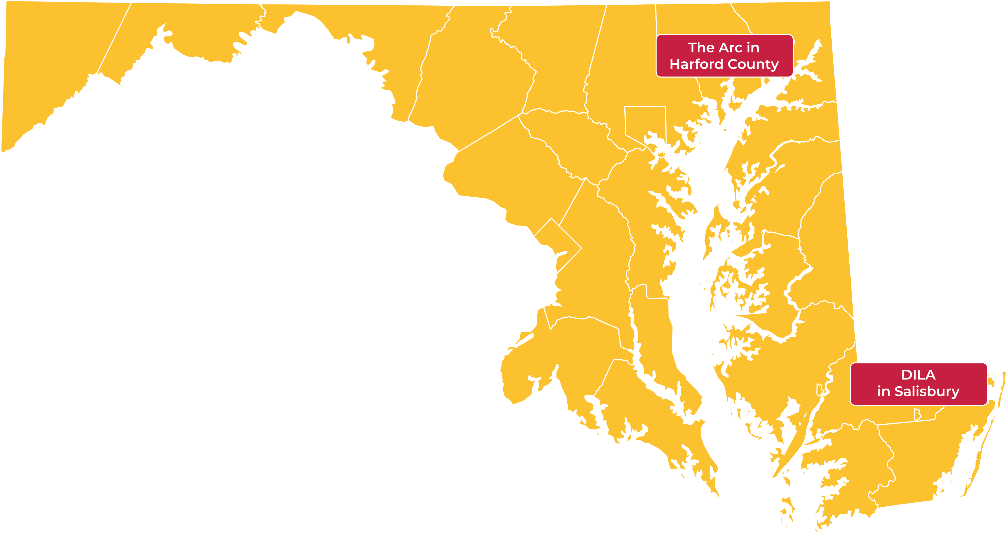
Evaluation Centers
Director‘s Report
October 15, 2021

Slide 38
Questions?

Slide 39
Public Relations & Outreach Report
Donna Broadway-Callaman
Community Outreach Manager
donnat.broadway-callaman@maryland.gov | 410-582-6158

Slide 40
What’s New With Maryland Relay?
In person outreach has started again.
We have attended the Maryland Association of Counties Conference (MACO) in Ocean City in August alongside the Department of Disabilities.
We also attended the Mid-Atlantic conference in September where we met a lot of different people from the region including those from Delaware, Virginia, and even as far as Washington State and we were able to share information on Maryland Relay and learn about what other states are doing.
We attended the fall Maryland Municipal League Conference earlier this week.
We will be:
Attending the Maryland Police Chiefs and Sheriffs Conference next week
Presenting at the MDrehabilitation DORS Conference in early November
Presenting at the National Federation of the Blind (NFB)
Sponsoring the Maryland Association of the Deaf Conference and Gala/Conference
Public Relations & Outreach Report
October 15, 2021

Slide 41
What’s New With Maryland Relay?
The 30th anniversary of our first relay call will be held at in our conference room at our office.
We will be having a bigger celebration in April that will be in person.
The December event will be hybrid with only speakers and special gifts attending the in-person celebration.
We will have a zoom link for everyone else who would like to participate.
Public Relations & Outreach Report
October 15, 2021

Slide 42
What’s New With Maryland Relay?
We held our first Lunch and Learn on October 7 with two sessions, one from 11 a.m. – 12 p.m. and the other from 12 – 1 p.m.
All sessions will be held via zoom.
Other dates include:
October 21
November 9
December 7
All dates will have two sessions.
Public Relations & Outreach Report
October 15, 2021

Slide 43
What’s New With Maryland Relay?
I have started field visits.
I have taken collateral to several places including state, city, and county agencies, senior homes, audiologists, and businesses with the idea that in person engagement will help generate interest in our programs.
So far, I have only distributed collateral in the Baltimore area, but I plan to do all 23 counties and Baltimore City.
Public Relations & Outreach Report
October 15, 2021

Slide 44
What’s New With Maryland Relay?
Outreach has a new designated email:
tam.outreach@maryland.gov
We will use this for RSVP’s and special outreach projects.
Public Relations & Outreach Report
October 15, 2021

Slide 45
Post Pandemic Outreach
Advertising
Webinars
Mailings
Virtual/Hybrid Events
Networking/Making New Contacts
Field Visits
Hamilton Relay Report
October 15, 2021

Slide 46
Questions?

Slide 47

Hamilton Relay
Updates

Slide 48
Maryland TRS
Percent Answered in 10 seconds
Hamilton Relay Report
October 15, 2021

Slide 49
Maryland Captioned Telephone
Percent Answered in 10 seconds
Hamilton Relay Report
October 15, 2021

Slide 50
Maryland TRS
Session & Conversation Minutes
Hamilton Relay Report
October 15, 2021

Slide 51
Maryland Captioned Telephone
Session & Conversation Minutes
Hamilton Relay Report
October 15, 2021

Slide 52
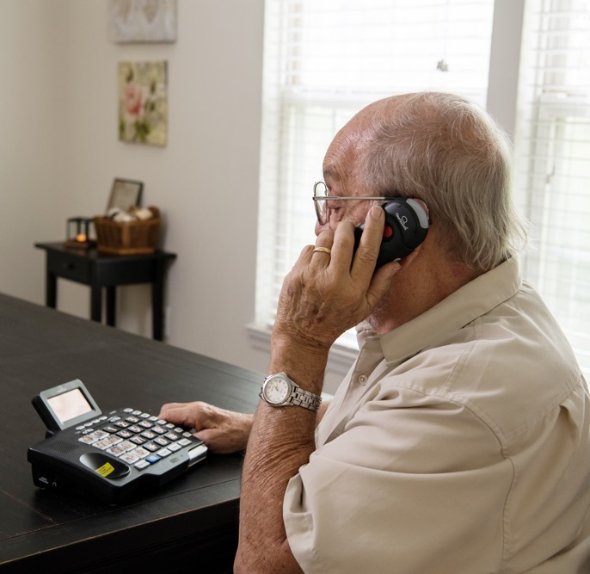
Maryland TRS
Customer Care Contacts
 | June | July | August
Technical | 0 | 2 | 0
General Information | 3 | 6 | 2
Equipment | 2 | 2 | 3
Customer Profile | 0 | 1 | 0
Outreach | 0 | 0 | 0
Operations Complaints | 0 | 1 | 0
External Complaints | 9 | 0 | 0
Wrong Number/Hang Up | 52 | 47 | 46
Compliments/Commendations | 0 | 0 | 0
Malicious Caller | 4 | 0 | 0
Hamilton Relay Report
October 15, 2021

Slide 53
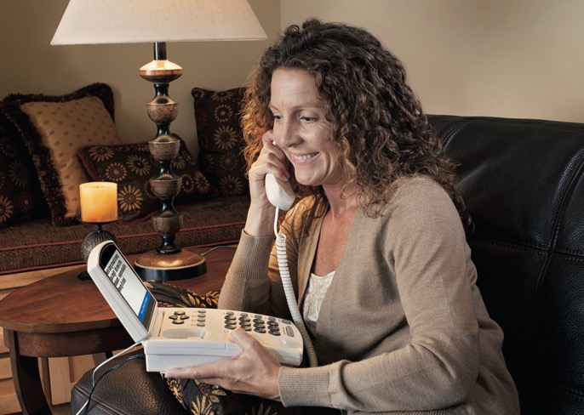
Maryland Captioned Telephone
Customer Care Contacts
 | June | July | August
Service | 0 | 0 | 0
Technical | 0 | 0 | 0
Product | 0 | 0 | 0
Billing | 0 | 0 | 0
Setup | 1 | 1 | 1
Info/Referral/Ed | 0 | 0 | 2
Other | 0 | 0 | 0
Hamilton Relay Report
October 15, 2021

Slide 54
Outreach Activity
12
Exhibits
(10 in-person)
15
Presentations
22
Networking Opportunities
80
Meetings
1
Sponsorship
For Baltimore County Department of Aging
(1 Relay Partner Training)
Hamilton Relay Report
October 15, 2021

Slide 55
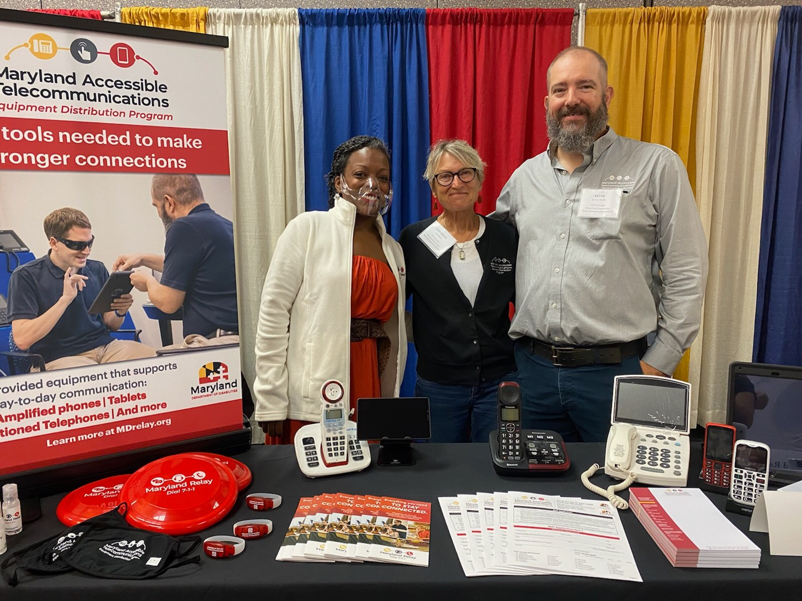
Outreach Highlights
Rebecca traveled to San Antonio to attend the Association of Public Safety Communications Officials International (APCO) Conference
Rebecca presented to 3 Public Safety Answering Points (PSAPs) about RTT services
Jenny traveled for the first time since March 2020 to Charles and Queen Anne’s County. Jenny was able to present to 7 Senior Centers.
Tech Expo 2021
Hamilton Relay Report
October 15, 2021

Slide 56
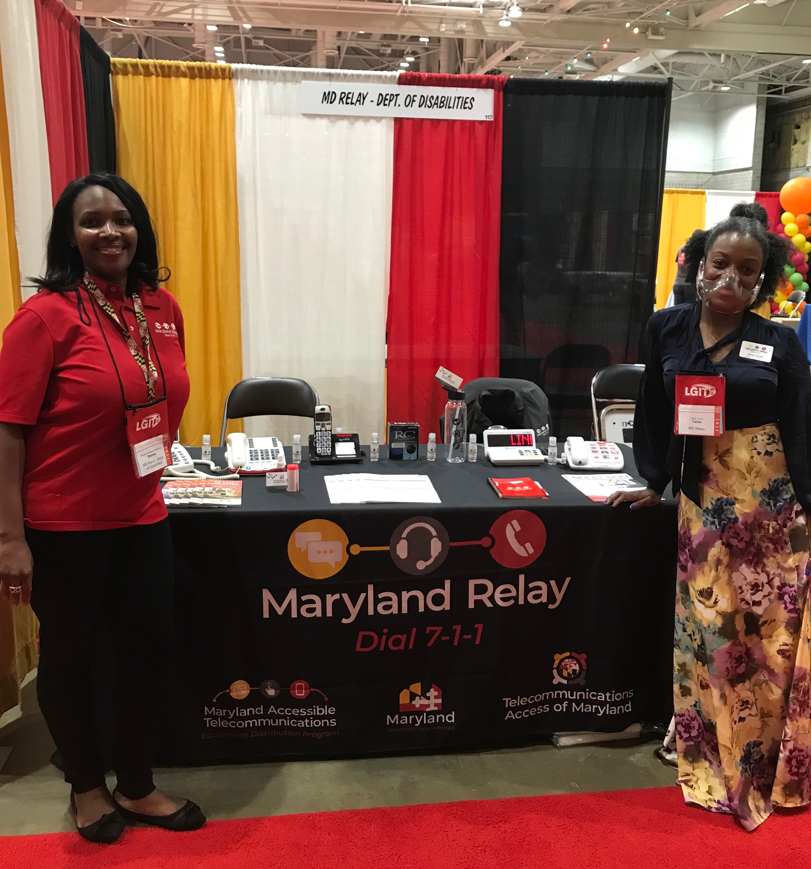
Outreach Highlights
Jenny gave a presentation to Maryland Access Point counselors who work throughout the state
Tarita attended conferences with the TAM staff in Ocean City, to include the Maryland Municipal League (MML) and the Maryland Association of Counties (MACo). Both were a huge success.
Tarita conducted a Relay Partner Training to Montage Marketing.
Maryland Municipal League (MML)
Hamilton Relay Report
October 15, 2021

Slide 57
Questions?

Slide 58
Thank you!
October 15, 2021

