Slide 1
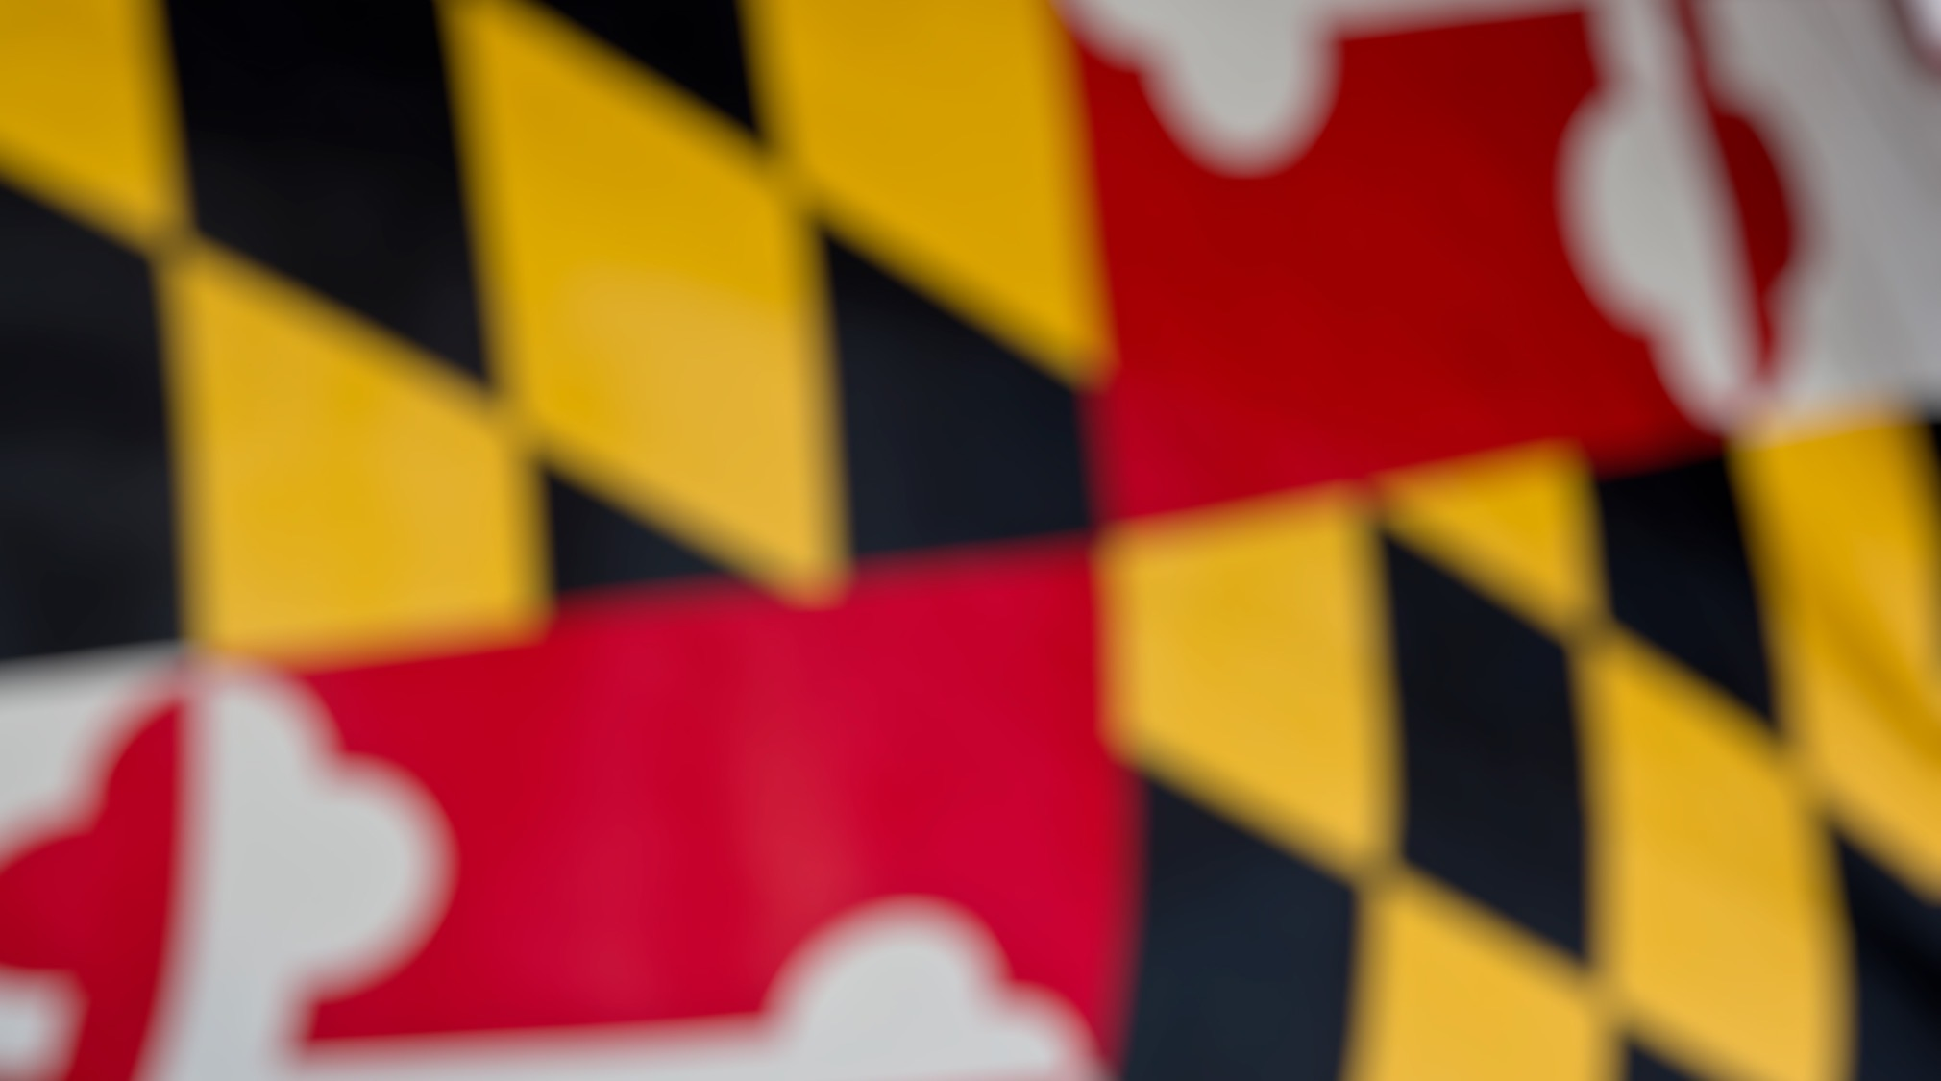
Governor’s Advisory Board for Telecommunications Relay
January 14, 2022

Slide 2

Director’s Report
David Bahar
Director
david.bahar@maryland.gov | 240-319-9199 (SMS)

Slide 3

Staffing Updates
MAT Program DeafBlind Specialist
Director‘s Report
January 14, 2022

Slide 4
GABTR Changes
Currently 3 open seats:
DeafBlind
MCOD
GODHH
Director‘s Report
January 14, 2022

Slide 5
Studio for Hybrid Events
Procurement of studio equipment is mostly complete.
Director‘s Report
January 14, 2022

Slide 6

Questions?

Slide 7
Finance Manager Report
Leslie Hannibal
TAM Finance Manager
Leslie.hannibal2@maryland.gov | 443-767-6971 (office)

Slide 8
USTF Financial Statement
Universal Service Trust Fund | Fiscal Year Actuals & Projections
Beginning Balance FY2020 | $13,883,429
Revenue (Interest) | -
Revenue (USTF RevenueTransfers) | $2,718,880 | 200,911 | 215,690 | 213,942 | 218,100 | 227,513 | 204,294 | 223,335 | 271,588 | 230,367 | 251,724 | 233,959 | 227,458
Actual / Projected Expenditures | $3,340,493 | 51,231 | 42,977 | 213,831 | 208,592 | 533,572 | 179,554 | 187,838 | 98,618 | 70,285 | 169,513 | 416,623 | 1,167,859
Transfers per the BRFA | -
Projected Ending Balance FY2020 | $13,261,817
Beginning Balance FY2021 | -
Revenue (Interest)
Revenue (USTF RevenueTransfers) | $16,044,194.18 | - | - | - | - | 231,082.16 | 251,494.63 | 228,320.58 | 14,078,454.70 | 230,661.08 | 243,988.52 | 221,771.42 | 558,421.09
Actual / Projected Expenditures | $3,633,265.12 | - | - | 15,547.12 | 43,251.72 | 182,628.51 | 21,953.49 | 970,239.85 | 48,503.66 | 107,579.11 | 709,939.20 | 191,940.63 | 1,341,681.83
Transfers per the BRFA
Projected Ending Balance FY2021 | $12,410,929.06
Beginning Balance FY2022 | $12,410,929.06
Revenue (Interest)
Revenue (USTF RevenueTransfers) | $1,165,886.76 | 227,411.00 | 247,028.68 | 222,412.64 | 239,217.95 | 229,816.49 | - | - | - | - | - | - | -
Actual / Projected Expenditures | $1,111,034.04 | 26,868.59 | 179,409.79 | 488,341.83 | 360,507.32 | 55,906.51 | - | - | - | - | - | - | -
Transfers per the BRFA
Projected Ending Balance FY2021 | $12,465,781.78
Finance Manager Report
January 14, 2022

Slide 9
USTF Current Balance
Finance Manager Report
January 14, 2022

Slide 10
USTF Projection Balance
Finance Manager Report
January 14, 2022

Slide 11

Manager Report
Travis Dougherty
Maryland Relay Manager
travis.dougherty@maryland.gov | 202-753-9119 (VP)

Slide 12
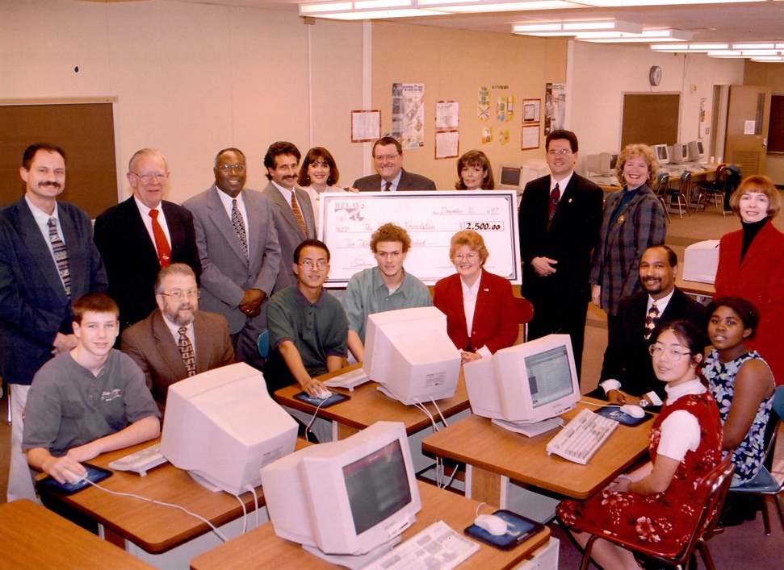
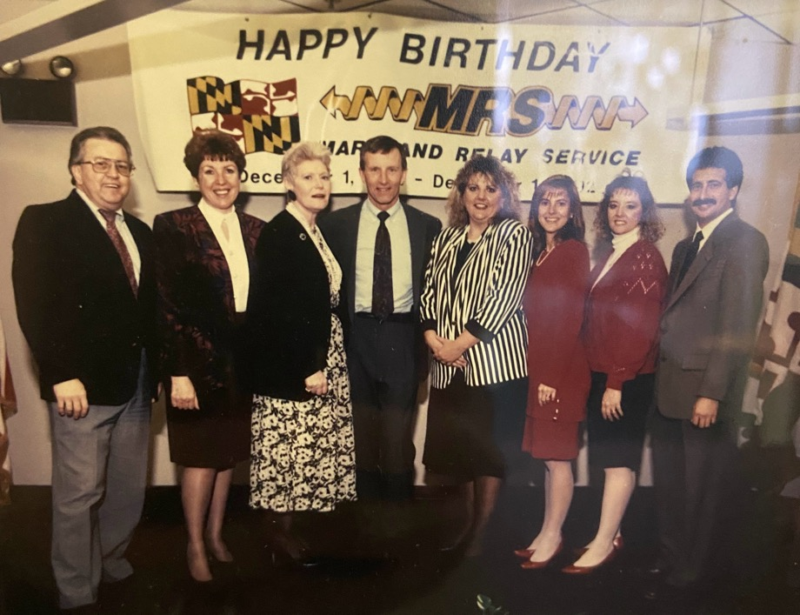
30th Anniversary of First Relay Call
Maryland Relay Manager Report
January 14, 2022

Slide 13
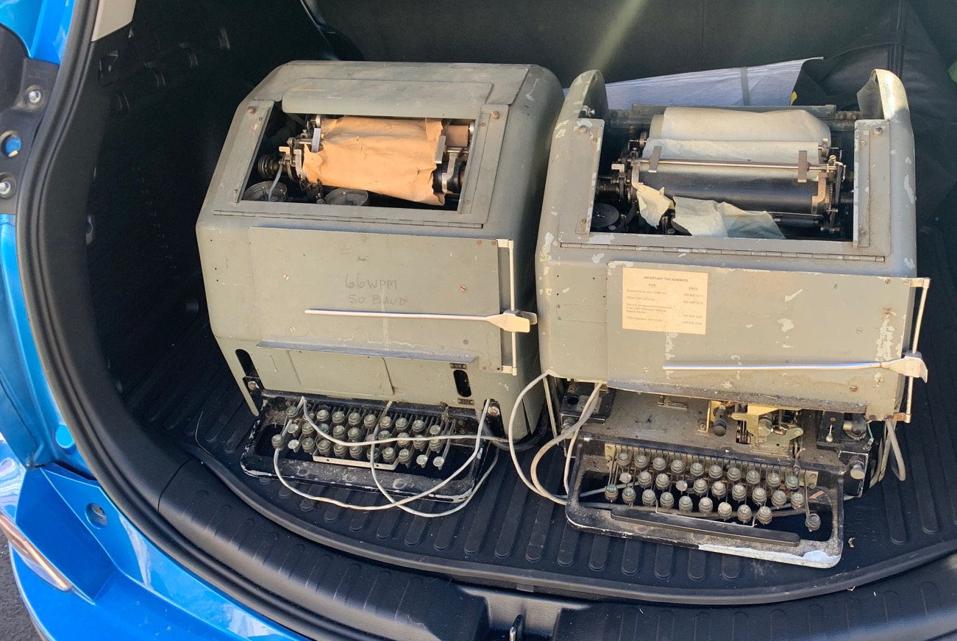
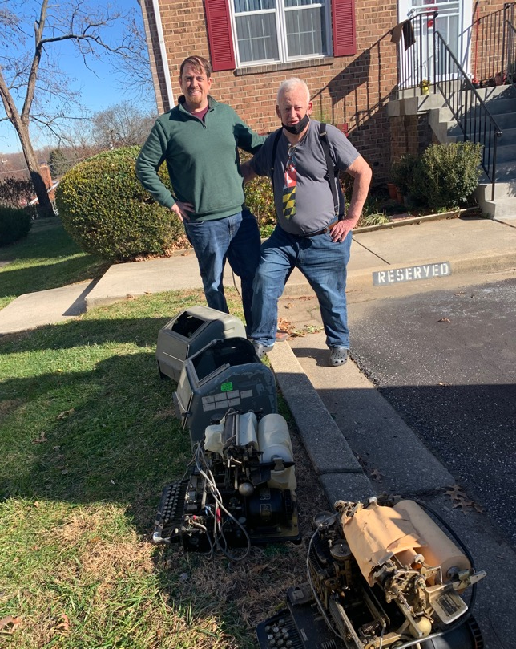
Recent TTY Donation
Maryland Relay Manager Report
January 14, 2022

Slide 14
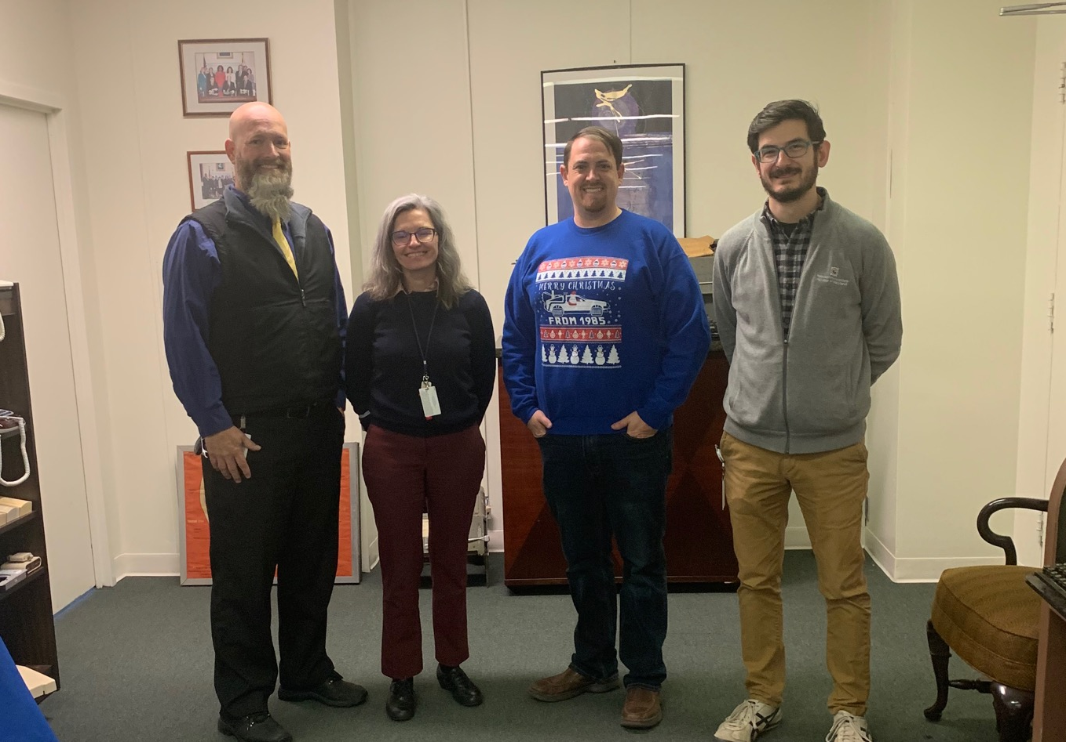
TAM Holiday Party
January 14, 2022

Slide 15

NASRA Updates
CTS Taskforce
Conference
Maryland Relay Manager Report
January 14, 2022

Slide 16
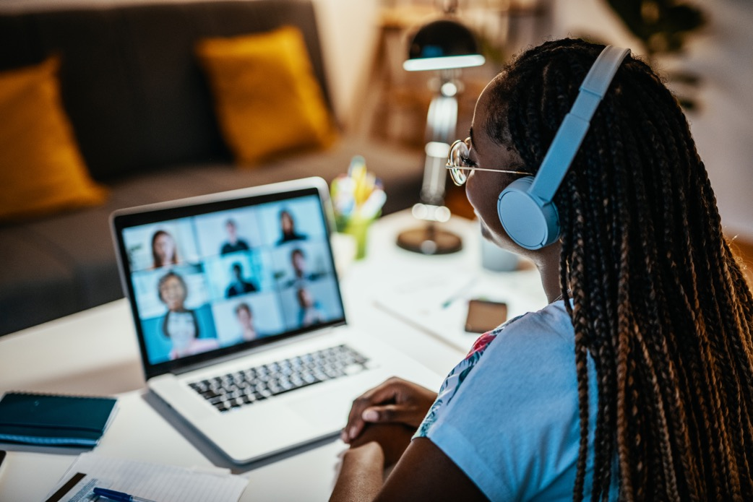
FCC’s Disability Advisory Committee
Workgroups:
Wireline RTT
TRS on Video Conference
Maryland Relay Manager Report
January 14, 2022

Slide 17
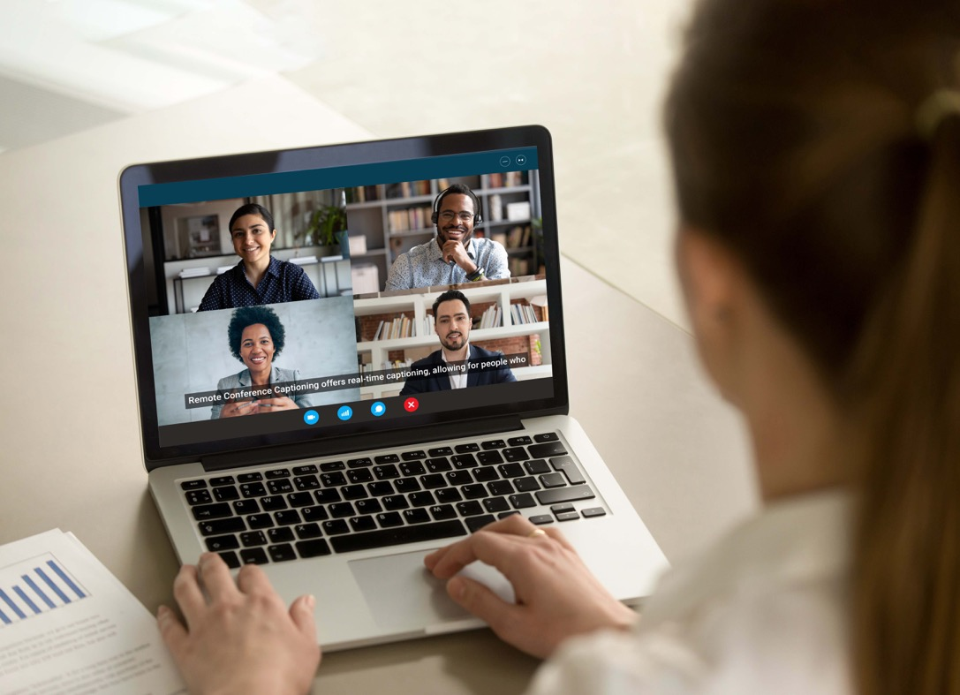
Captioning
RCC Updates
Federal Relay / GSA
Captioning Relay Service
Maryland Relay Manager Report
January 14, 2022

Slide 18
Questions?

Slide 19

MAT Manager Report
Kevin Steffy
MAT Manager
kevin.steffy@maryland.gov | 443-852-6717 (SMS)

Slide 20
General Updates
From October to December 2021, MAT has received 49 new applications and distributed a total of 82 pieces of telecommunications equipment.
In the previous quarterly report, we received 69 new applications and distributed a total of 69 pieces of telecommunications equipment.
MAT Manger Report
January 14, 2022

Slide 21
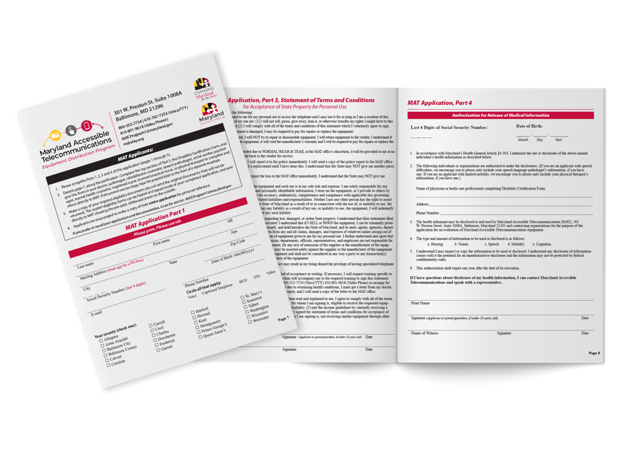
MAT Application Form
Devaney created the MAT Application form with large fonts for low vision people, the Spanish language, and braille for blind people.
We will work to add an e-signature to our online application form.
MAT Manger Report
January 14, 2022

Slide 22
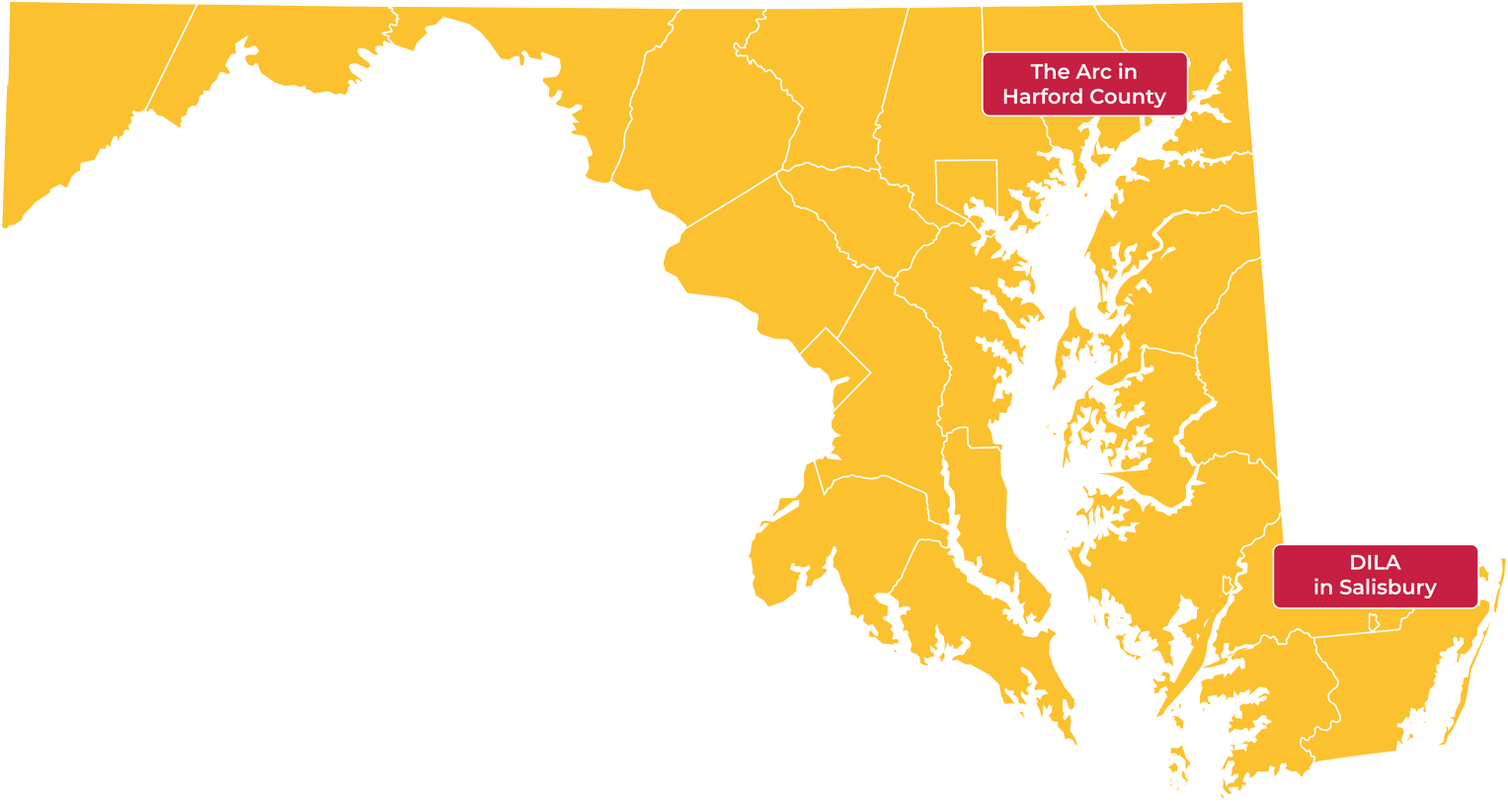
Evaluation Centers
Maintaining Active Citizen (MAC)
Easter Seals
IMAGE centers
Director‘s Report
January 14, 2022

Slide 23
Assistance Telecommunications Equipment (ATE)
Release date: January 6th
Numbers of Service Categories: from 11 to 16
Director‘s Report
January 14, 2022

Slide 24
Lunch & Learn
The committee (Kevin, Jane, Donna, Tarita, Jenny, Rebecca, and Melissa) had a meeting to wrap up and share our feedback to improve our Lunch and Learn.
Donna will be chairing the events in 2022.
We will host Lunch and Learn events for the following professionals: physician, audiologist, rehabilitation counselor, speech language pathologist, social worker, psychologist, mental health counselor, nurse, some more health care professionals to mention.
Donna will share more information on the Lunch & Learn during her report.
MAT Manger Report
January 14, 2022

Slide 25
Open Position
DeafBlind Specialist
MAT Manger Report
January 14, 2022

Slide 26
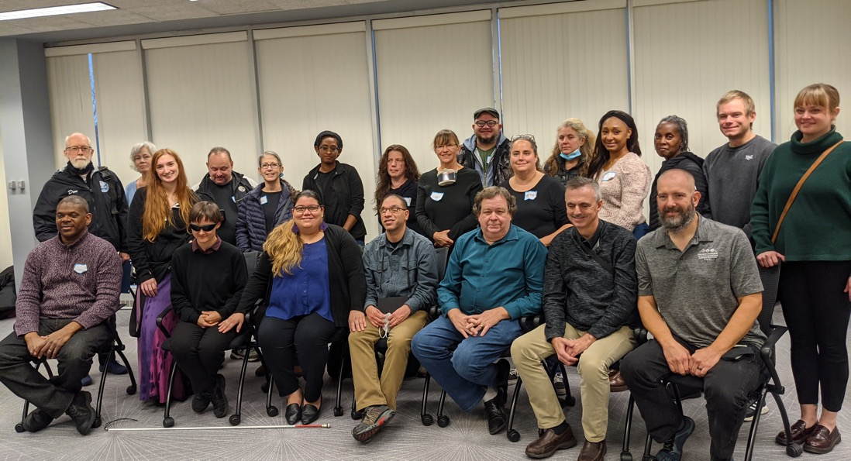
Communication Facilitator (CF)
We hosted CF training on Sunday, November 21, 2021 at Maryland Deaf Community Center (MDCC) in Frederick. There were 28 participants signed up and 22 showed up.
We had 4 volunteers to help the committee during the training, 4 DeafBlind individuals, and 8 CDIs.
The training was successful. We provided pizzas, salad, and drinks from Mozzeria.
Communication Facilitator Training
Director‘s Report
January 14, 2022

Slide 27
Communication Facilitator continued…
The Communication Facilitator (CF) program had its first CF service on Friday, December 17, 2021 at a DeafBlind person’s house with two facilitators.
Those facilitators facilitated the information and what was said during the Zoom to DB person by the Tactile sign language (signed into the DeafBlind person’s hands) and the Pro-Tactile language (touch-based to allow DeafBlind person to have more reliable information about the visual elements of their environment such as people laughing/nodding or hand raising, where people sit or stand, etc.).
Director‘s Report
January 14, 2022

Slide 28
Questions?

Slide 29
Public Relations & Outreach Report
Donna Broadway-Callaman
Community Outreach Manager
donnat.broadway-callaman@maryland.gov | 410-582-6158

Slide 30
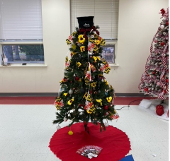
What’s New With Maryland Relay?
Since we last met, we have pivoted our outreach efforts to include community events, law enforcement communities, business with relay partner trainings, 911 PSAP and RTT trainings.
We attended the Aberdeen Whoville craft fair and sponsored a tree for the Festival of Trees
We presented at Parkville High School in Baltimore County
We hosted an outreach table at the Randallstown Library in Baltimore County
Aberdeen Whoville craft fair
Public Relations & Outreach Report
January 14, 2022

Slide 31
What’s New With Maryland Relay?
We recently attended winter MACO and made good contacts.
We connected with public officials from all over the state. There was an NG911 demonstration, and I was able to share contacts from PSAP’s around the state with our outreach team.
Upcoming events include:
Maryland Relay Library Association
Brain Injury Association of Maryland
Public Relations & Outreach Report
January 14, 2022

Slide 32

What’s New With Maryland Relay?
We recently held our 30th anniversary celebration at our office on December 1. Past directors, staff, and GABTR members attended the celebration.
It went well and we are planning to have another celebration in April to celebrate the opening of the TAM office. We will share more information later.
Public Relations & Outreach Report
January 14, 2022

Slide 33
What’s New With Maryland Relay?
In 2022, we will be planning a series of collaborative presentations similar to our lunch and learns but we plan to collaborate and work with different agencies around the state. We will be reaching out to various GABTR members because the sessions will focus on the communities the members of this board serves.
During the slow season, we will be doing mailings and field visits, which includes taking collateral to several places including state, city, and county agencies, senior homes, audiologists, and businesses with the idea that in person engagement will help generate interest in our programs.
Public Relations & Outreach Report
January 14, 2022

Slide 34
Outreach Activity
32
Exhibits
13
Presentations
20
Networking Opportunities
41
Meetings
2
Sponsorships
Hamilton Relay Report
January 14, 2022

Slide 35
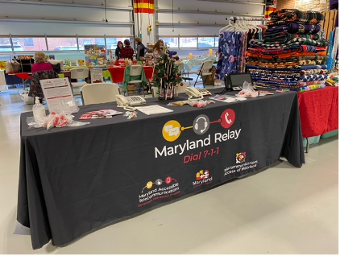
Outreach Highlights
Tarita gave a presentation about Speech-to-Speech services to the Stroke Survivor's Support Group in Towson, Maryland.
Rebecca attended her very first in-person event in September 2021. Along with Tarita and Donna, she managed the table at the ADA conference in Baltimore City.
Jenny visited the Richard Clark Senior Center, in Charles County, for a Veteran's Day event
ADA Conference in Baltimore City
Public Relations & Outreach Report
January 14, 2022

Slide 36
Continued Outreach Efforts
Advertising
Webinars
Mailings
Virtual/Hybrid Events
Networking/Making New Contacts
Field Visits
Hamilton Relay Report
January 14, 2022

Slide 37
Questions?

Slide 38

Hamilton Relay
Updates

Slide 39
Maryland TRS
Percent Answered in 10 seconds
Hamilton Relay Report
January 14, 2022

Slide 40
Maryland Captioned Telephone
Percent Answered in 10 seconds
Hamilton Relay Report
January 14, 2022

Slide 41
Maryland TRS
Session & Conversation Minutes
Hamilton Relay Report
January 14, 2022

Slide 42
Maryland Captioned Telephone
Session & Conversation Minutes
Hamilton Relay Report
January 14, 2022

Slide 43
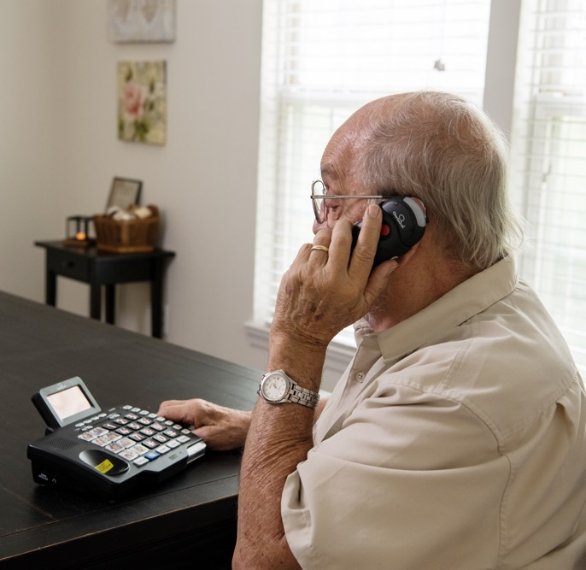
Maryland TRS
Customer Care Contacts
 | Sept | Oct | Nov
Technical | 0 | 1 | 2
General Information | 11 | 7 | 7
Equipment | 0 | 5 | 1
Customer Profile | 3 | 1 | 5
Outreach | 0 | 0 | 0
Operations Complaints | 0 | 0 | 0
External Complaints | 0 | 0 | 0
Wrong Number/Hang Up | 29 | 38 | 35
Compliments/Commendations | 0 | 0 | 0
Malicious Caller | 0 | 0 | 0
Hamilton Relay Report
January 14, 2022

Slide 44
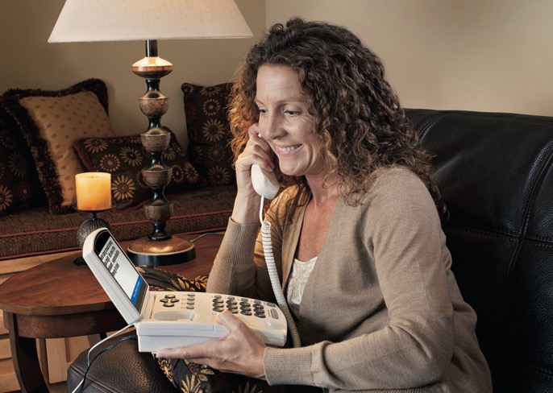
Maryland Captioned Telephone
Customer Care Contacts
 | Sept | Oct | Nov
Service | 0 | 0 | 0
Technical | 0 | 0 | 0
Product | 0 | 0 | 0
Billing | 0 | 0 | 0
Setup | 1 | 1 | 1
Info/Referral/Ed | 1 | 1 | 0
Other | 0 | 0 | 0
Hamilton Relay Report
January 14, 2022

Slide 45
Outreach Highlights
In October, Tarita had the opportunity to attend the grand opening of the Maryland Deaf Community Center’s grand opening. Tarita not only had a table there alongside the MAT team, but she also donated an item for the silent auction.
In November, Rebecca was able to present to NENA’s Joint Committee Meeting about RTT services. This virtual summit set the goal to have several other RTT working groups in the future through NENA and got the attention of many key players in the organization who had limited knowledge of what RTT is and how important it will be for accessibility in 911 in the near future.
Hamilton Relay Report
January 14, 2022

Slide 46
Upcoming Plans
The outreach team already has events planned for the winter months between now and the next GABTR meeting.
For example, thanks to some great networking while exhibiting at the Randallstown Public Library, Jenny will be giving a presentation to the Westside Networking Group in February 2022.
This is a group for librarians, businesses, and some non-profit organizations on the west side of Baltimore.
Hamilton Relay Report
January 14, 2022

Slide 47
GABTR Gratitude
Alex Simmons
We would like to recognize and thank Alex Simmons for his support during the grand opening of the Maryland Deaf Community Center. Not only is Alex a board member but he’s also on the board at MDCC. It’s always great seeing GABTR members in the community when we are out-reaching!
Hamilton Relay Report
January 14, 2022

Slide 48
SCHOLARSHIP OPPORTUNITY
It’s that time again!
Hamilton Relay is looking for graduating high school students who are deaf, hard of hearing or have a speaking difficulty to award a scholarship to.
Paying for college can be a challenge; let Hamilton Relay help! If you or someone you know is a dynamic graduating senior in high school, encourage them to apply for the scholarship today.
Contact Tarita Turner (tarita.turner@hamiltonrelay.com) for more information and check social media for posts about an upcoming informational session to learn more about the scholarship program!
The deadline is January 31, 2022, so don’t delay.
January 14, 2022

Slide 49
Questions?

Slide 50
Thank you!
January 14, 2022

