Slide 1
Governor’s Advisory Board for Telecommunications Relay
January 15, 2021

Slide 2
Director’s Report
David Bahar

Slide 3
Staffing Update
TAM Finance Director recruitment:
Expected in first half of 2021
Director‘s Report
January 15, 2021

Slide 4
Financial Update
 | FY17 Actuals | FY18 Actuals | FY19 Actuals | FY20 Actuals | FY21 Projections
Beginning Balance | $14,404421 | $14,229,803 | $13,907,802 | $13,883,429
Revenue (Interest) | $0 | $0 | $0 | $0
Revenue | $2,961,097 (@ $0.5/acct) | $2,427,978 | $2,633,409 | $2,868,810
Expenditures | $3,135,715 | $2,749,979 | $2,347,288 | $2,550,021
Beginning BRFA Transfers | $0 | $0 | $0 | $0
Ending Balance | $14,229,803 | $13,907,802 | $13,883,429 | $14,202,218
Director‘s Report
January 15, 2021

Slide 5
Senior Call Check
Senior Call Check (SCC) program manager Arnold Eppel has left MDoA.
Mr. Eppel has been replaced by Peter Tuths.
Secretary Kramer of MDoA has agreed to share Senior Call Check program invoices quarterly instead of annually so that TAM can obtain better insight into SCC program expenditures.
A meeting with Mr. Tuths is scheduled for the end of January 2021.
Director‘s Report
January 15, 2021

Slide 6
GABTR Update
New Member: Glenn Lockhart
Meet Glenn Lockhart, one of our newest GABTR members, representing the Deaf community. With almost a decade of work experience in TRS—which includes interacting with TRS users at consumer, industry, and Deaf community events—Glenn hopes to continue to build on consumer education and engagement and bring his unique perspective to the Board. In addition to GABTR, Glenn is involved with organizations such as Telecommunications for the Deaf, Inc (TDI), the Maryland Association of the Deaf (MDAD), the American Civil Liberties Union (ACLU), and the Association of Governing Boards (AGB). In his free time, he enjoys reading (especially science fiction), doing puzzles, and exercising.
Director‘s Report
January 15, 2021

Slide 7
Questions?

Slide 8
Manager Report
Travis Doughtery
Maryland Relay Manager
travis.doughtery@maryland.gov | 202-753-9119 (VP)

Slide 9
RCC’s New Features
Embedded Captions
When accessing meetings via Zoom, Adobe Connect, or others, RCC users can now benefit from an integrated captioning experience in lieu of split-screen viewing.
Print Transcript
This feature can be found at the top of the user’s screen and is present for the duration of the session. Once the Captionist leaves the session, this feature becomes unavailable. As such, please be sure to click the “Print Transcript” button as the meeting is ending.
Maryland Relay Manager Report
January 15, 2021

Slide 10
RTT Development Updates
Issues with Carriers
RTT Revolution Campaign
Maryland Relay Manager Report
January 15, 2021

Slide 11
Concerns
Declining minutes of TTY
Only around 8% of all CapTel phones in Maryland have been active in the last few months.
Maryland Relay Manager Report
January 15, 2021

Slide 12
Questions?

Slide 13
Manager Report
Kevin Steffy

Slide 14
General Updates
From October to December 2020, MAT has received 35 new applications and distributed a total of 115 pieces of telecommunications equipment
In the previous quarterly report, we distributed a total of 35 pieces of telecommunications equipment
There is a difference of 80 equipment pieces between the previous and current quarters
Evaluators are still doing the evaluation/re-evaluation/troubleshooting remotely as much as possible.
We are still performing our services remotely to protect the health of our staff and our clients. If we must meet with clients in person as a last resource, it is with the understanding that we must use PPE and ensure that everything is properly sanitized
Most of the senior and nursing centers still are not allowing evaluators to come in for the assessment until further notice
MAT Manger Report
January 15, 2021

Slide 15
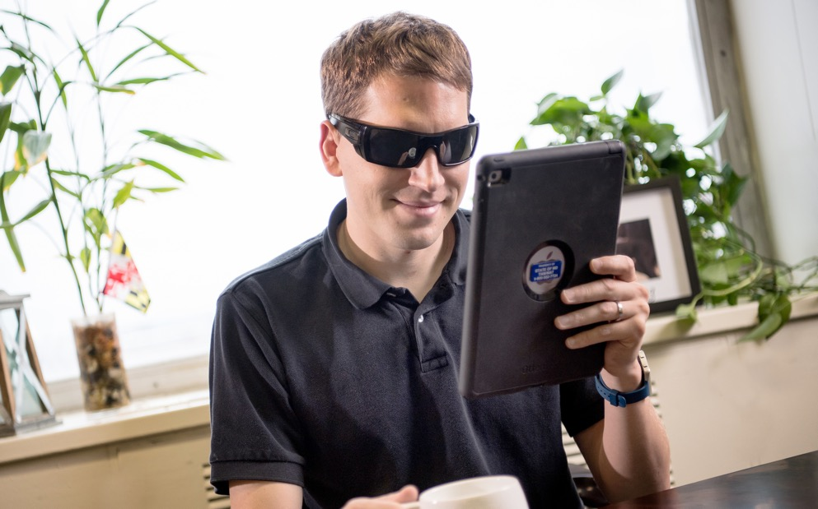
Equipment Update
Below are the numbers for distributed equipment from October to December 2020
Amplified Phone: 71
Amplified Phone with Amplified Voice Output: 2
Captioned Telephone: 3
Hands-Free Phone: 1
iPad: 37
Synthetic Speech System: 1
Wireless Device: 7
MAT Manger Report
January 15, 2021

Slide 16
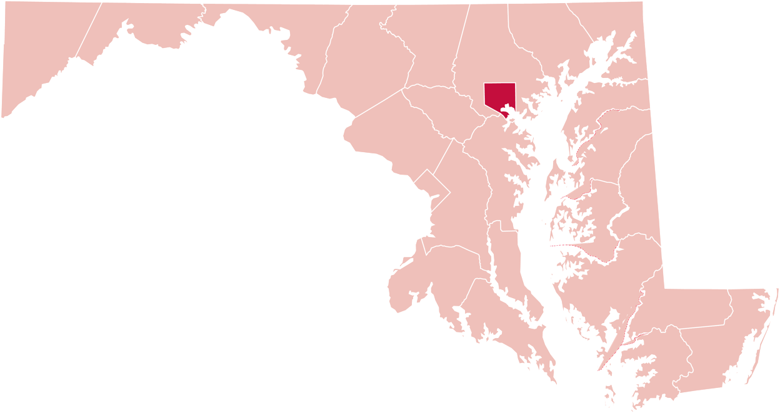
Equipment Update
Below are the numbers for distributed equipment by county from October to December 2020
Allegany County
1
Carroll County
3
43
Baltimore County
1
Cecil County
Baltimore City
39
2
Harford County
Washington County
10
7
Anne Arundel County
Montgomery County
2
Howard County
3
1
Wicomico County
Prince George’s County
3
2
Worcester County
St Mary’s County
3
MAT Manger Report
January 15, 2021

Slide 17
Equipment Update
Below are the numbers for distributed equipment from July to December 2020
Amplified Answering Machine: 1
Amplified Phone: 122
Amplified Phone with Amplified Voice Output: 2
Captioned Telephone: 16
Hands-Free Phone: 1
iPad: 55
Memory Dialing Aid: 1
Miscellaneous: 1
Phone Ring Signaler: 1
Synthetic Speech System: 1
Wireless Device: 9
MAT Manger Report
January 15, 2021

Slide 18
Equipment Update
Below are the numbers for distributed equipment by county from July to December 2020
Allegany County
2
Carroll County
4
64
Baltimore County
1
Cecil County
Baltimore City
4
Harford County
58
Washington County
11
2
Queen Anne’s County
Frederick County
9
2
Talbot County
Montgomery County
6
1
Calvert County
Howard County
5
2
Dorchester County
Prince George’s County
8
2
Wicomico County
St Mary’s County
4
4
Worcester County
MAT Manger Report
Anne Arundel County
14
January 15, 2021

Slide 19
Focus Groups
We hosted our first focus group virtual webinar for the Hard of Hearing group on Friday, December 18, 2020.
Jane Hager and I hosted and ran the webinar with 4 pieces of equipment.
The 4 pieces of equipment were:
Pixel 4
XLC8-GLT
Quattro Pro 4.0
mobile alert
7 out of 10 participants showed up.
Devaney & Associates, Travis Dougherty, and Latricia Lee helped us run the survey and PowerPoint presentation. The focus group was successful and I'm looking forward to hosting the second group. The upcoming focus group will concentrate on a low vision/blind/cognitive impairment audience.
MAT Manger Report
January 15, 2021

Slide 20
MAT Application Form
Devaney & Associates, Donna Broadway-Callaman, and I have been working to revise the MAT application. Donna submitted the MAT application form to AG Hisham Amin for his review and approval. Hopefully, it will be done and ready to print as soon as possible.
MAT Manger Report
January 15, 2021

Slide 21
Questions?

Slide 22
Public Relations & Outreach Report
Donna Broadway-Callaman
Outreach Manager
donnat.broadway-callaman@maryland.gov | 410-582-6158

Slide 23
What’s New With Maryland Relay?
Rebecca Miller has been successfully trained has hit the ground running with her work on the upcoming RTT webinars and with attending PSAP meetings
We have hired four interns to work with all the MAT managers with each of our programs
We have finished the majority of our rebranding efforts and we are now focused on updating our website which is currently under DoIT but will be transitioned to DoD soon. We have made edits to our DoIT website but will do a full revamp of our website once it is transferred to DoD.
Public Relations & Outreach Report
January 15, 2021

Slide 24
How Maryland Relay is Staying Connected During COVID-19
Advertising
Webinars
Mailings
Virtual events
Networking/making new contacts
We are not sure when in person events and large events will resume but our outreach coordinators continue to work very hard sourcing virtual outreach opportunities
Public Relations & Outreach Report
January 15, 2021

Slide 25
Winter 2021 Newsletter
We are currently working on our Winter 2021 newsletter. It does not have a definite release date but some of the content we are working on includes:
Holiday Recap from TAM – photos of staff and holiday message to community updating current status of office hours/MAT
Evaluations/outreach, and things to look forward to in the new year
Update on Real-Time Text – NASRA presentation (?)
Outreach Webinars – promote their availability, topics, and upcoming dates
Remote Conference Captioning – how to use it, success stories, update on embedded captioning on Zoom
MAT program – Information/summary of the focus groups
Past sponsorships and community involvement – NAFRE, Beacon, Maryland Library Association, Maryland Community Action Partnership
Action Partnership Conference, etc.
Public Relations & Outreach Report
January 15, 2021

Slide 26
Winter 2021 Newsletter
During this quarter: we will continue promoting our webinars, virtual presentations, virtual events, sponsorships, and networking. As well as our MAT programs, various MAT outreach and promotion, RCC, and RTT promotion, as well as completing our rebranding efforts with new videos, and more promotional items. We will not resume in person outreach until all of the COVID-19 restrictions are lifted by Governor Hogan.
Public Relations & Outreach Report
January 15, 2021

Slide 27
Questions?

Slide 28
Hamilton Relay
Updates

Slide 29
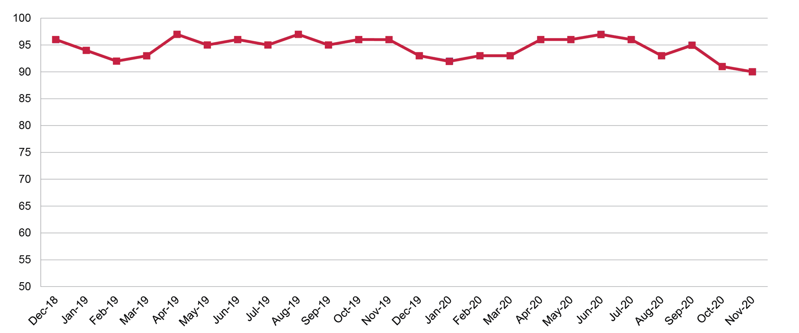
Maryland TRS
Percent Answered in 10 seconds
Hamilton Relay Report
January 15, 2021

Slide 30
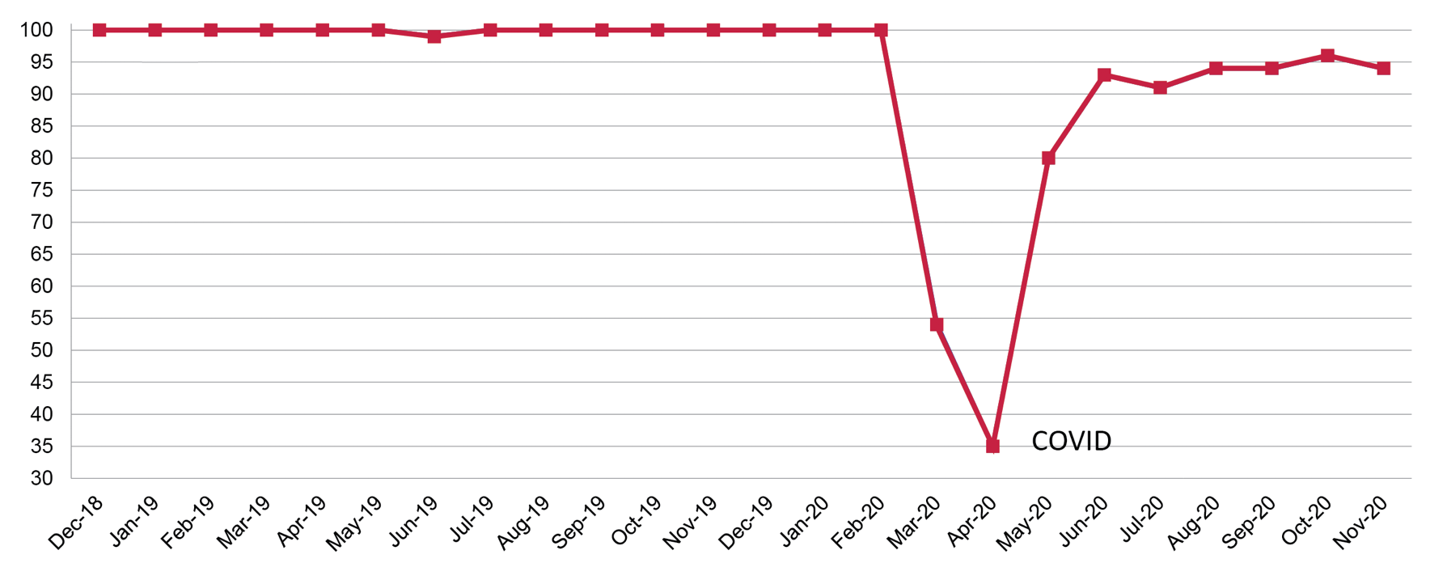
Maryland Captioned Telephone
Percent Answered in 10 seconds
Hamilton Relay Report
January 15, 2021

Slide 31
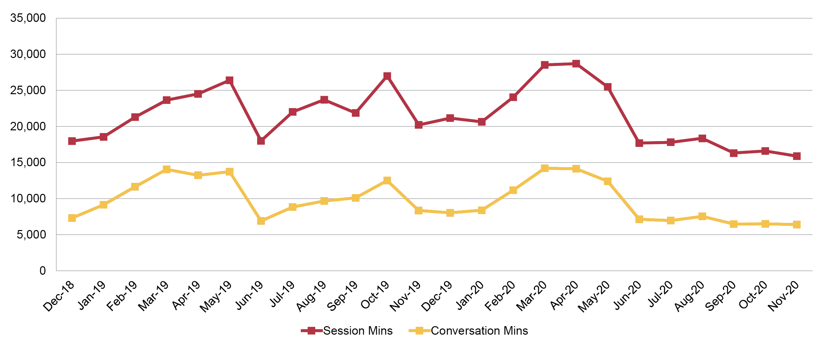
Maryland TRS
Session & Conversation Minutes
Hamilton Relay Report
January 15, 2021

Slide 32
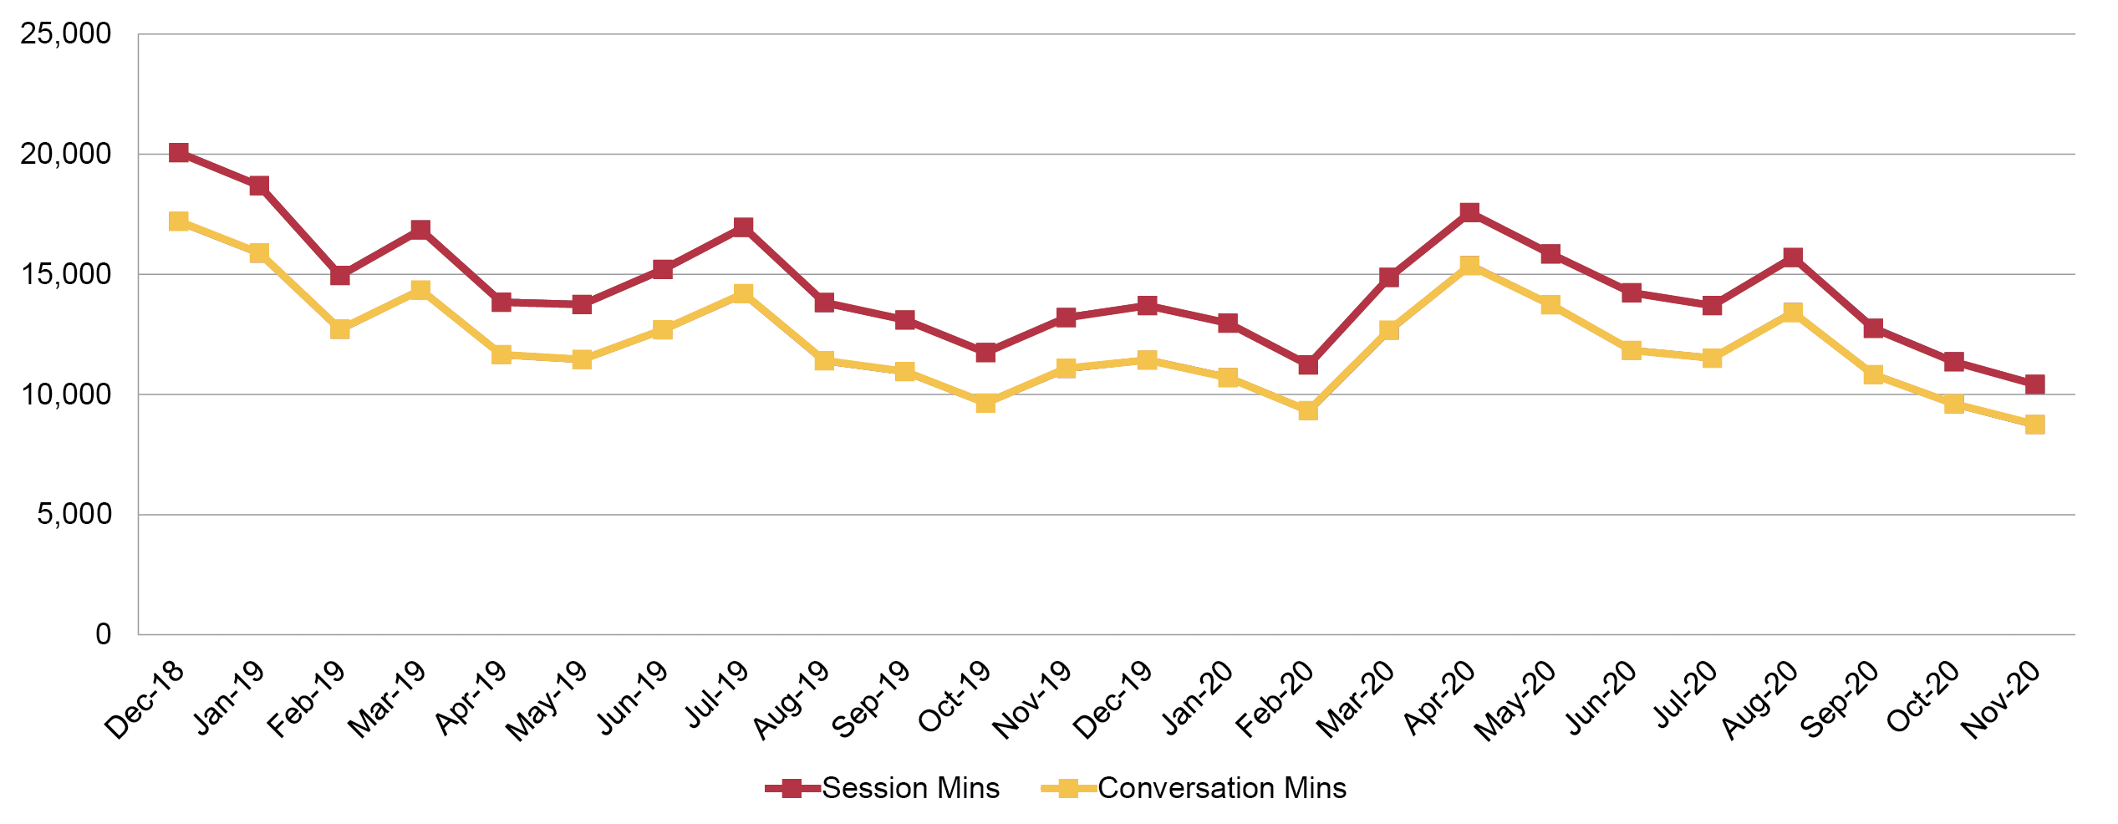
Maryland Captioned Telephone
Session & Conversation Minutes
Hamilton Relay Report
January 15, 2021

Slide 33
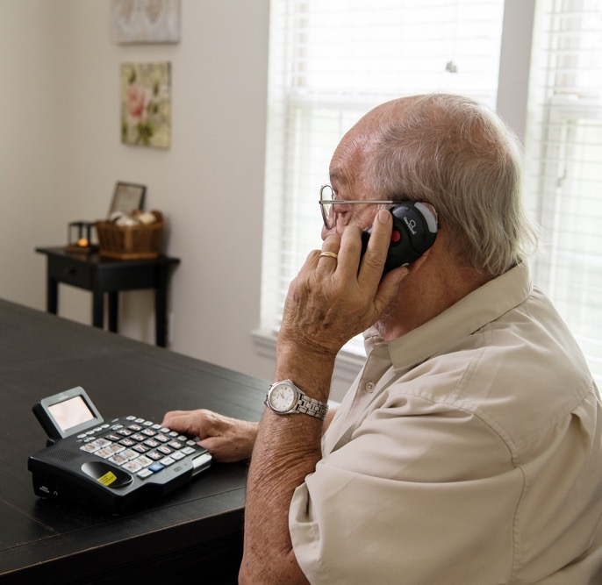
Maryland TRS
Customer Care Contacts
 | September | October | November
Technical | 0 | 0 | 0
General Information | 13 | 10 | 3
Equipment | 3 | 3 | 2
Customer Profile | 1 | 1 | 2
Outreach | 0 | 0 | 0
Operations Complaints | 0 | 0 | 0
External Complaints | 0 | 0 | 0
Wrong Number/Hang up | 94 | 46 | 48
Compliments/Commendations | 0 | 0 | 0
Malicious Caller | 0 | 0 | 0
Hamilton Relay Report
January 15, 2021

Slide 34
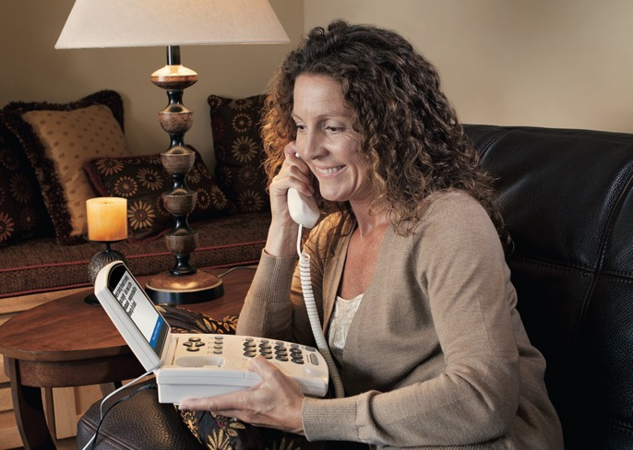
Maryland Captioned Telephone
Customer Care Contacts
 | September | October | November
Service | 0 | 0 | 0
Technical | 0 | 0 | 0
Product | 0 | 0 | 0
Billing | 0 | 0 | 0
Setup | 0 | 2 | 0
Info/Referral/Ed | 0 | 0 | 0
Other | 0 | 0 | 0
Hamilton Relay Report
January 15, 2021

Slide 35
Outreach Efforts
Outreach Efforts from October to December 2020
11 Virtual Exhibits
36 Meetings
31 Networking Meetings
15 Webinars
Hamilton Relay Report
January 15, 2021

Slide 36
Outreach Highlights
The Outreach team has been working with various agencies that concentrate on empowering people with disabilities to maintain their independence. Maryland Relay can have an active role in this goal and the Outreach team continues to identify and share the benefits and opportunities.
Rebecca Miller, RTT Outreach Coordinator, began attending the Maryland 911 Board Meeting to learn about what’s important to PSAPs and how RTT plays a role in this environment.
The Outreach team has been presenting Statewide webinars with engaged audiences. Keep an eye on Social Media to learn about upcoming webinars.
Hamilton Relay Report
January 15, 2021

Slide 37
Outreach News
We are making exciting forward progress with RTT and our communication with stakeholders.
Hamilton is seeking current graduating high school seniors who are Deaf, Hard of Hearing, or have a speaking difficulty to apply for a scholarship. The deadline for applications is January 30, 2021.
Hamilton Relay Report
January 15, 2021

Slide 38
Questions?

Slide 39
Thank you!
January 15, 2021

